Slide 1
Kubernetes in Action
Part IV
2026.08.25

Slide 2
Volumes
Attaching Disk Storage to Containers

Slide 3
What Is Volume?
File System Resources :
  We’ve said that pods are similar to logical hosts where processes running inside them share resources such as CPU, RAM, network interfaces, and others. One would expect the processes to also share disks, but that’s not the case. You’ll remember that each container in a pod has its own isolated filesystem, because the filesystem comes from the container’s image.
  Every new container starts off with the exact set of files that was added to the image at build time. Combine this with the fact that containers in a pod get restarted (either because the process died or because the liveness probe signaled to Kubernetes that the container wasn’t healthy anymore) and you’ll realize that the new container will not see anything that was written to the filesystem by the previous container, even though the newly started container runs in the same pod.
  In certain scenarios you want the new container to continue where the last one finished, such as when restarting a process on a physical machine. You may not need (or want) the whole filesystem to be persisted, but you do want to preserve the directories that hold actual data.
  Kubernetes provides this by defining storage volumes. They aren’t top-level resources like pods, but are instead defined as a part of a pod and share the same lifecycle as the pod. This means a volume is created when the pod is started and is destroyed when the pod is deleted. Because of this, a volume’s contents will persist across container restarts. After a container is restarted, the new container can see all the files that were written to the volume by the previous container. Also, if a pod contains multiple containers, the volume can be used by all of them at once.

Slide 4
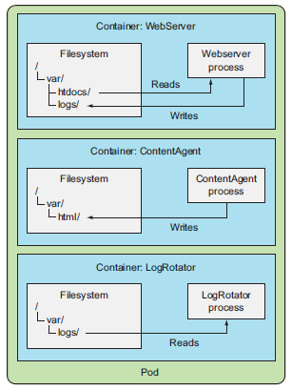
Introducing Volumes(1/4)
Volumes :
  Kubernetes volumes are a component of a pod and are thus defined in the pod’s specification—much like containers. They aren’t a standalone Kubernetes object and cannot be created or deleted on their own. A volume is available to all containers in the pod, but it must be mounted in each container that needs to access it. In each container, you can mount the volume in any location of its filesystem.
  Imagine you have a pod with three containers (shown in the following figure). One container runs a web server that serves HTML pages from the “/var/htdocs” directory and stores the access log to “/var/logs”. The second container runs an agent that creates HTML files and stores them in “/var/html”. The third container processes the logs it finds in the “/var/logs” directory (rotates them, compresses them, analyzes them, or whatever).

Slide 5
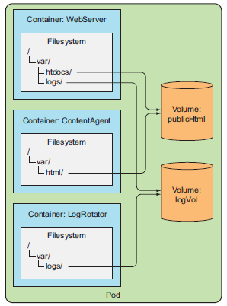
Introducing Volumes(2/4)
Volumes :
  Each container has a nicely defined single responsibility, but on its own each container wouldn’t be of much use. Creating a pod with these three containers without them sharing disk storage doesn’t make any sense, because the content generator would write the generated HTML files inside its own container and the web server couldn’t access those files, as it runs in a separate isolated container. Instead, it would serve an empty directory or whatever you put in the “/var/htdocs” directory in its container image. Similarly, the log rotator would never have anything to do, because its “/var/logs” directory would always remain empty with nothing writing logs there. A pod with these three containers and no volumes basically does nothing.
  If you add two volumes to the pod and mount them at appropriate paths inside the three containers, as shown in the following figure, you’ve created a system that’s much more than the sum of its parts.

Slide 6
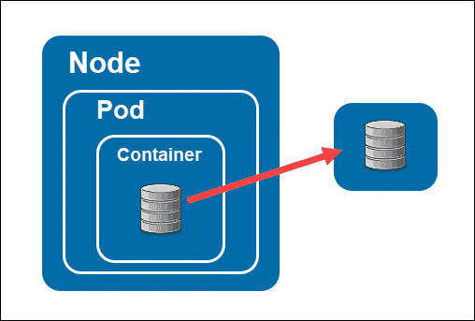
Introducing Volumes(3/4)
Volumes :
  Linux allows you to mount a filesystem at arbitrary locations in the file tree. When you do that, the contents of the mounted filesystem are accessible in the directory it’s mounted into. By mounting the same volume into two containers, they can operate on the same files. In your case, you’re mounting two volumes in three containers. By doing this, your three containers can work together and do something useful.
  First, the pod has a volume called “publicHtml”. This volume is mounted in the WebServer container at “/var/htdocs”, because that’s the directory the web server serves files from. The same volume is also mounted in the ContentAgent container, but at “/var/html”, because that’s where the agent writes the files to. By mounting this single volume like that, the web server will now serve the content generated by the content agent.
  Similarly, the pod also has a volume called “logVol” for storing logs. This volume is mounted at “/var/logs” in both the WebServer and the LogRotator containers. Note that it isn’t mounted in the ContentAgent container. The container cannot access its files, even though the container and the volume are part of the same pod. It’s not enough to define a volume in the pod; you need to define a “VolumeMount” inside the container’s spec also, if you want the container to be able to access it.
  The two volumes in this example can both initially be empty, so you can use a type of volume called “emptyDir”. Kubernetes also supports other types of volumes that are either populated during initialization of the volume from an external source, or an existing directory is mounted inside the volume. This process of populating or mounting a volume is performed before the pod’s containers are started.
  A volume is bound to the lifecycle of a pod and will stay in existence only while the pod exists, but depending on the volume type, the volume’s files may remain intact even after the pod and volume disappear, and can later be mounted into a new volume.

Slide 7
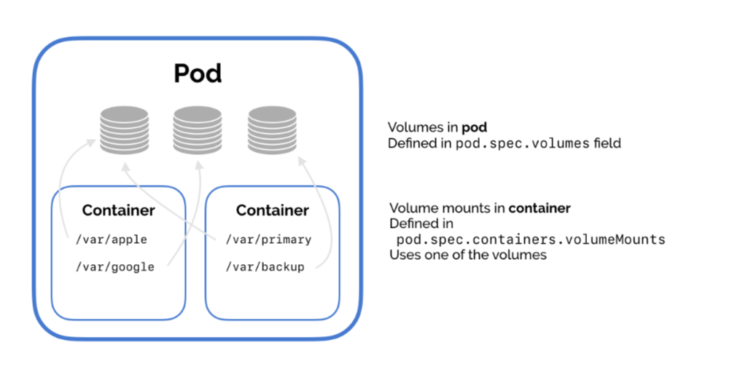
Introducing Volumes(4/4)
Volume Types :
  A wide variety of volume types is available. Several are generic, while others are specific to the actual storage technologies used underneath. You’ll probably only use volume types for the technologies you already know and use. Here’s a list of several of the available volume types :
    emptyDir—A simple empty directory used for storing transient data.
    hostPath—Used for mounting directories from the worker node’s filesystem into the pod.
    gitRepo—A volume initialized by checking out the contents of a Git repository.(Deprecated)
    nfs—An NFS(Network File System) share mounted into the pod.
    gcePersistentDisk (Google Compute Engine Persistent Disk), awsElasticBlockStore (Amazon Web Services Elastic Block Store Volume), azureDisk (Microsoft Azure Disk Volume)—Used for mounting cloud provider-specific storage.
    cinder, cephfs, iscsi, flocker, glusterfs, quobyte, rbd, flexVolume, vsphereVolume, photonPersistentDisk, scaleIO—Used for mounting other types of network storage.
    configMap, secret, downwardAPI—Special types of volumes used to expose certain Kubernetes resources and cluster information to the pod.
    persistentVolumeClaim—A way to use a pre- or dynamically provisioned persistent storage.
  A single pod can use multiple volumes of different types at the same time, and each of the pod’s containers can either have the volume mounted or not.
  NOTICE : Some of the above volume types are already deprecated. Check the status of the volume types in https://kubernetes.io/docs/concepts/storage/volumes/ before you use it.

Slide 8
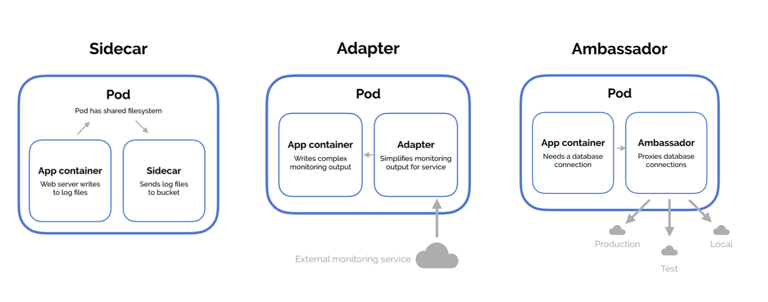
Using Volumes(1/8)
Using an emptyDir Volume :
  The simplest volume type is the emptyDir volume. As the name suggests, the volume starts out as an empty directory. The app running inside the pod can then write any files it needs to it. Because the volume’s lifetime is tied to that of the pod, the volume’s contents are lost when the pod is deleted.
  An emptyDir volume is especially useful for sharing files between containers running in the same pod. But it can also be used by a single container for when a container needs to write data to disk temporarily, such as when performing a sort operation on a large dataset, which can’t fit into the available memory. The data could also be written to the container’s filesystem itself, but subtle differences exist between the two options. A container’s filesystem may not even be writable, so writing to a mounted volume might be the only option.
  You’ll build a pod with only the web server container and the content agent and a single volume for the HTML.
  You’ll use Nginx as the web server and the UNIX “fortune” command to generate the HTML content. The fortune command prints out a random quote every time you run it. You’ll create a script that invokes the “fortune” command every 10 seconds and stores its output in “index.html”.

Slide 9
NOTE : Building Docker Image(1/2)
Building the Fortune Docker Image :
  Create a new directory called “fortune” and then inside it, create a “fortuneloop.sh” shell script with the following contents :
  Then, in the same directory, create a file called “Dockerfile” file containing the following :
  The image is based on the “ubuntu:20.04” image, which doesn’t include the “fortune” binary by default. That’s why in the second line of the “Dockerfile” you install it with “apt-get”. After that, you add the “fortuneloop.sh” script to the image’s /bin folder. Then you specify that the “fortuneloop.sh” script should be executed when the image is run(ENTRYPOINT).
  NOTE : If you specify the Ubuntu as “latest” instead of “20.04”, there will be public key issue in running “apt-update” command. So I just used “20.04” for the Ubuntu version.
  NOTICE : You need to change the permission of the “fortuneloop.sh” to be executed in the container. So change the permission with “$ chmod 0777 fortuneloop.sh” command.
#!/bin/bash
trap "exit" SIGINT
mkdir /var/htdocs
while :
do
echo $(date) Writing fortune to /var/htdocs/index.html
/usr/games/fortune > /var/htdocs/index.html
sleep 10
done
fortuneloop.sh
FROM ubuntu:20.04
RUN apt-get update ; apt-get -y install fortune
ADD fortuneloop.sh /bin/fortuneloop.sh
ENTRYPOINT /bin/fortuneloop.sh
Dockerfile

Slide 10
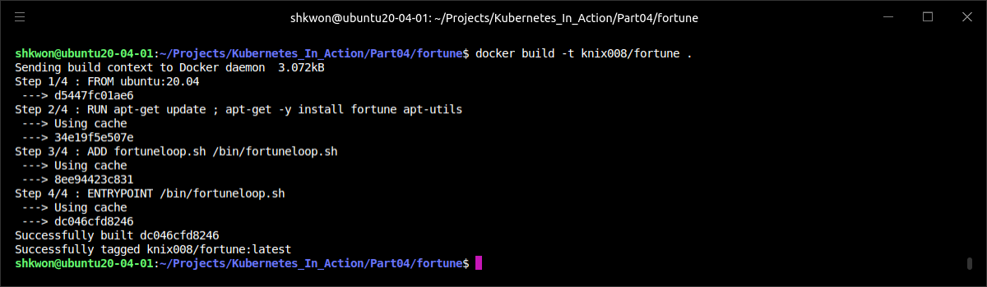
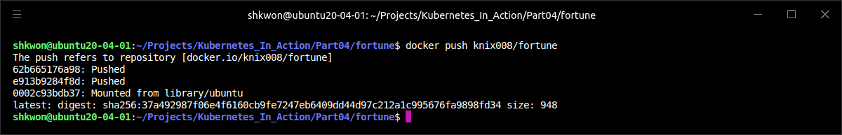
NOTE : Building Docker Image(2/2)
Building the Fortune Docker Image :
  After preparing both files, build and upload the image to Docker Hub with the following two commands :
$ docker build -t knix008/fortune .
$ docker push knix008/fortune

Slide 11
Using Volumes(2/8)
Using an emptyDir Volume :
  Create a file called “fortune-pod.yaml” with the contents shown in the following listing.
  NOTICE : Make sure that “fortuneloop.sh” can be executed. Before you build docker image, you need to change the permission of the “fortuneloop.sh” shell script.
apiVersion: v1
kind: Pod
metadata:
name: fortune
spec:
containers:
- image: knix008/fortune
name: html-generator
volumeMounts:
- name: html
mountPath: /var/htdocs
- image: nginx:alpine
name: web-server
volumeMounts:
- name: html
mountPath: /usr/share/nginx/html
readOnly: true
ports:
- containerPort: 80
protocol: TCP
volumes:
- name: html
emptyDir: {}
fortune-pod.yaml

Slide 12
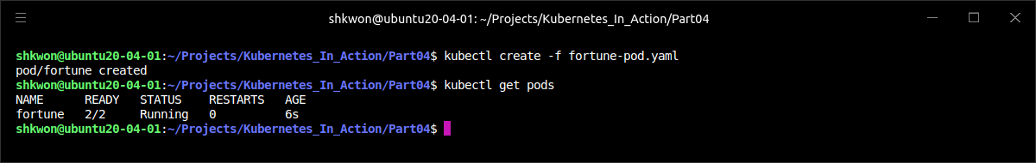
Using Volumes(3/8)
Using an emptyDir Volume :
  The pod contains two containers and a single volume that’s mounted in both of them, yet at different paths. When the “html-generator” container starts, it starts writing the output of the fortune command to the “/var/htdocs/index.html” file every 10 seconds. Because the volume is mounted at “/var/htdocs”, the “index.html” file is written to the volume instead of the container’s top layer. As soon as the “web-server” container starts, it starts serving whatever HTML files are in the “/usr/share/nginx/html” directory (this is the default directory Nginx serves files from). Because you mounted the volume in that exact location, Nginx will serve the “index.html” file written there by the container running the “fortuneloop.sh”. The end effect is that a client sending an HTTP request to the pod on port 80 will receive the current fortune message as the response.

Slide 13
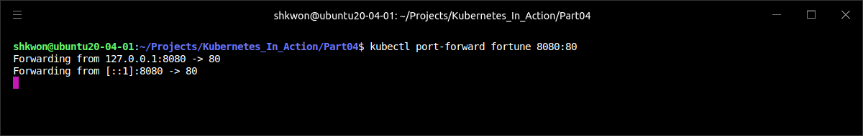
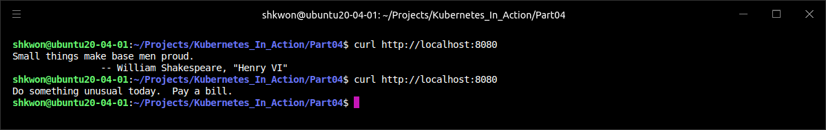
Using Volumes(4/8)
Using an emptyDir Volume :
  To see the fortune message, you need to enable access to the pod. You’ll do that by “forwarding a port(port forwarding)” from your local machine to the pod :
  NOTE : As an exercise, you can also expose the pod through a service instead of using port forwarding.
  Now you can access the Nginx server through port 8080 of your local machine. Use curl to do that :
$ kubectl port-forward fortune 8080:80
$ curl http://localhost:8080

Slide 14
Using Volumes(5/8)
Using an emptyDir Volume :
  The “emptyDir” you used as the volume was created on the actual disk of the worker node hosting your pod, so its performance depends on the type of the node’s disks.
  You can also tell Kubernetes to create the “emptyDir” on a “tmpfs” filesystem (in memory instead of on disk). To do this, set the emptyDir’s “medium” to “Memory” like this :
  An emptyDir volume is the simplest type of volume, but other types build upon it. After the empty directory is created, they populate it with data.
apiVersion: v1
kind: Pod
metadata:
name: fortune
spec:
containers:
…
volumes:
- name: html
emptyDir:
medium: Memory
fortune-pod.yaml

Slide 15
Using Volumes(6/8)
Using an emptyDir Volume :
  To use Github repository for your volume, you need to use “initContainers” container(specialized containers that run before app containers in a Pod. Init containers can contain utilities or setup scripts not present in an app image. You can specify init containers in the Pod specification alongside the containers array, which describes app containers.) instead of “gitRepo” volume type.
apiVersion: v1
kind: Pod
metadata:
name: gitrepo-volume-pod
spec:
initContainers:
- name: git-clone
image: alpine/git
args:
- clone
- https://github.com/knix008/Website
- /repo
volumeMounts:
- name: git-repository
mountPath: /repo
containers:
- image: nginx:alpine
name: web-server
volumeMounts:
- name: git-repository
mountPath: /usr/share/nginx/html
readOnly: true
ports:
- containerPort: 80
protocol: TCP
volumes:
- name: git-repository
emptyDir: {}
gitrepo-volume-pod.yaml
initContainers
emptyDir

Slide 16
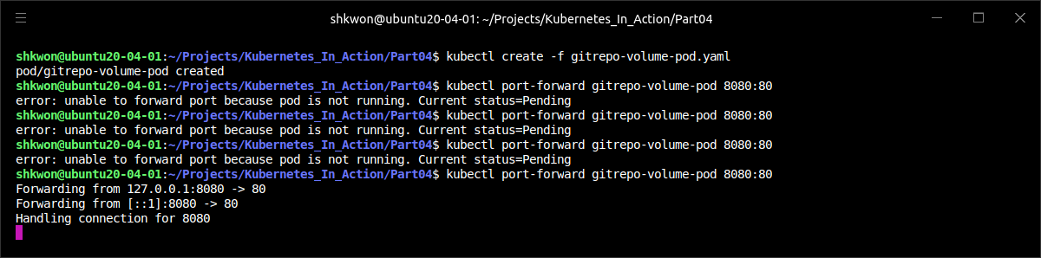
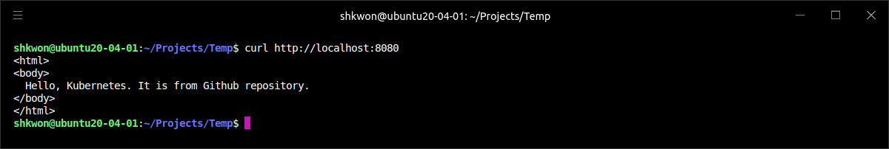
Using Volumes(7/8)
Using an emptyDir Volume :
  In “initContainers” specification, we used “git” command to clone the https://github.com/knix008/Website into “/repo”. The “/repo” is the mounted from the “git-repository” in emptyDir type “volume”.
$ kubectl create -f gitrepo-volume-pod.yaml
$ kubectl port-forward gitrepo-volume-pod 8080:80
…
In other terminal
$ curl http://localhost:8080

Slide 17
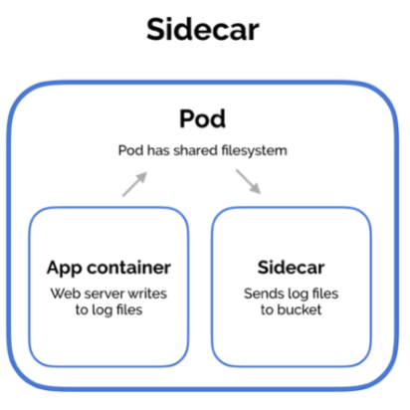

Using Volumes(8/8)
Sidecar Containers :
  The Git sync process shouldn’t run in the same container as the Nginx web server, but in a second container: a sidecar container. A sidecar container is a container that augments the operation of the main container of the pod. You add a sidecar to a pod so you can use an existing container image instead of cramming additional logic into the main app’s code, which would make it overly complex and less reusable.
  To find an existing container image, which keeps a local directory synchronized with a Git repository, go to Docker Hub and search for “git sync.” You’ll find many images that do that. Then use the image in a new container in the pod from the previous example, mount the pod’s existing volume in the new container, and configure the Git sync container to keep the files in sync with your Git repo. If you set everything up correctly, you should see that the files the web server is serving are kept in sync with your GitHub repo.
git sync

Slide 18
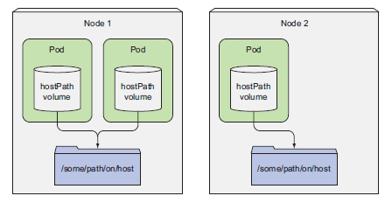
Accessing Files on the Worker Node’s Filesystem(1/5)
hostPath Volume :
  Most pods should be oblivious of their host node, so they shouldn’t access any files on the node’s filesystem. But certain system-level pods (remember, these will usually be managed by a DaemonSet) do need to either read the node’s files or use the node’s filesystem to access the node’s devices through the filesystem. Kubernetes makes this possible through a “hostPath” volume.
  A hostPath volume points to a specific file or directory on the node’s filesystem (see the following figure). Pods running on the same node and using the same path in their hostPath volume see the same files.
  hostPath volumes are the first type of persistent storage, because the emptyDir volume’s contents get deleted when a pod is torn down, whereas a hostPath volume’s contents don’t. If a pod is deleted and the next pod uses a hostPath volume pointing to the same path on the host, the new pod will see whatever was left behind by the previous pod, but only if it’s scheduled to the same node as the first pod.

Slide 19
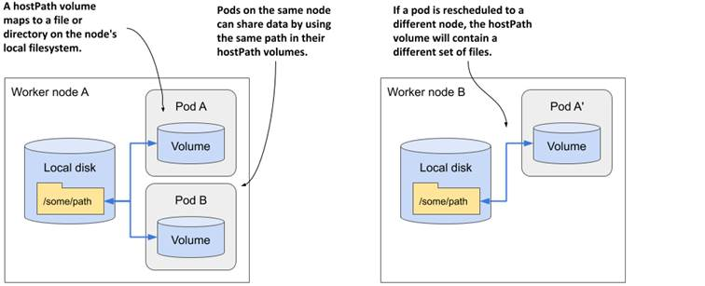
Accessing Files on the Worker Node’s Filesystem(2/5)
hostPath Volume :
  Because the volume’s contents are stored on a specific node’s filesystem, when a pod gets rescheduled to another node, it will no longer see the data. This explains why it’s not a good idea to use a hostPath volume for regular pods, because it makes the pod sensitive to what node it’s scheduled to.

Slide 20
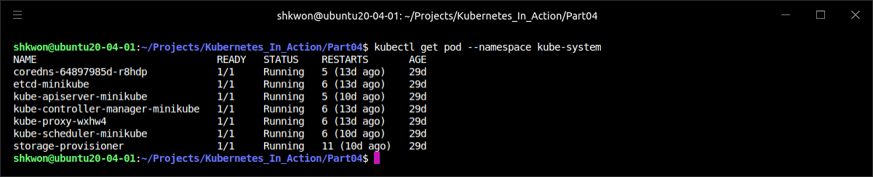
Accessing Files on the Worker Node’s Filesystem(3/5)
Examining System Pods That Use hostPath Volumes :
  Let’s see how a hostPath volume can be used properly. Instead of creating a new pod, let’s see if any existing system-wide pods are already using this type of volume. As you may remember from one of the previous examples, several such pods are running in the “kube-system” namespace. Let’s list them again :
$ kubectl get pod --namespace kube-system

Slide 21
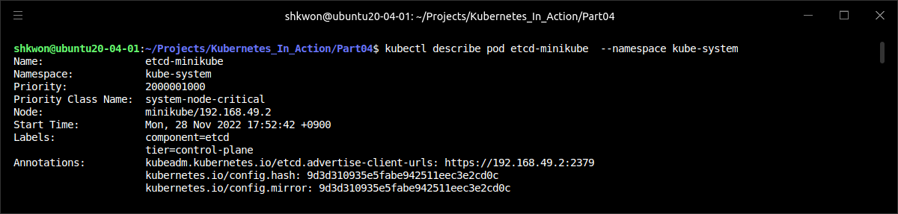
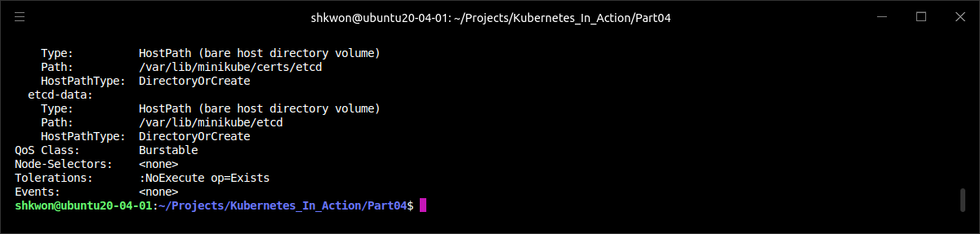
Accessing Files on the Worker Node’s Filesystem(4/5)
Examining System Pods That Use hostPath Volumes :
  Pick one pod from the previous listing and see what kinds of volumes it uses (shown in the following listing).

Slide 22
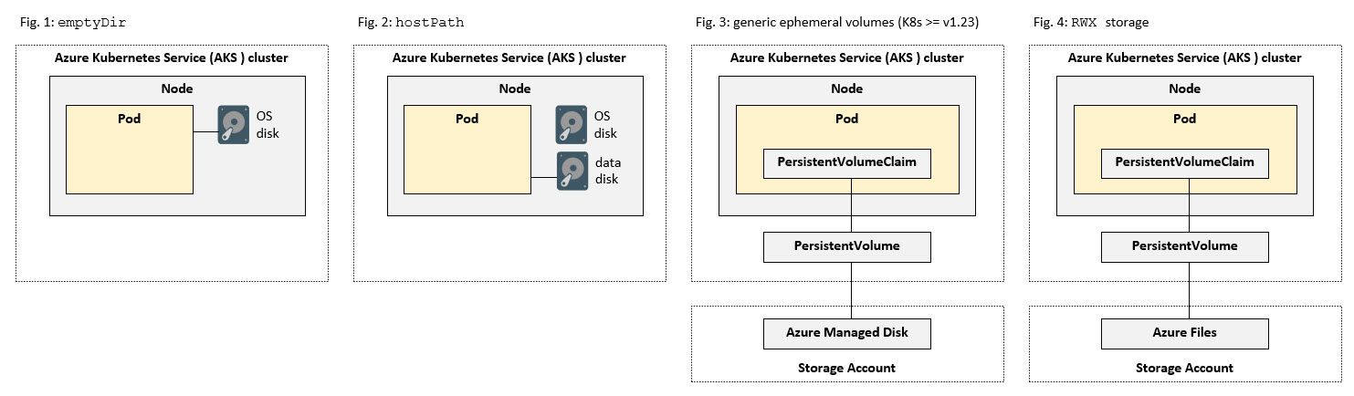
Accessing Files on the Worker Node’s Filesystem(5/5)
Examining System Pods That Use hostPath Volumes :
  The pod uses two hostPath volumes to gain access to the node’s “/var/lib/minikube/certs/etcd” and the “/var/lib/minikube/etcd” directories.
  If you inspect the other pods, you’ll see some of them uses the hostPath volume for storing their own data. They use it to get access to the node’s data. hostPath volumes are often used for trying out persistent storage in single-node clusters, such as the one created by Minikube. Read on to learn about the types of volumes you should use for storing persistent data properly even in a multi-node cluster.
  TIP : Remember to use hostPath volumes only if you need to read or write system files on the node. Never use them to persist data across pods.

Slide 23
Using Persistent Storage(1/2)
Persistent Storage :
  When an application running in a pod needs to persist data to disk and have that same data available even when the pod is rescheduled to another node, you can’t use any of the volume types we’ve mentioned so far. Because this data needs to be accessible from any cluster node, it must be stored on some type of network-attached storage (NAS).
  Now you will create a hostPath PersistentVolume. Kubernetes supports hostPath for development and testing on a single-node cluster. A hostPath PersistentVolume uses a file or directory on the Node to emulate network-attached storage.
  In a production cluster, you would not use hostPath. Instead a cluster administrator would provision a network resource like a Google Compute Engine(GCE) persistent disk, an NFS share, or an Amazon Elastic Block Store volume. Cluster administrators can also use StorageClasses to set up dynamic provisioning.
apiVersion: v1
kind: Pod
metadata:
name: mongodb
spec:
volumes:
- name: mongodb-data
hostPath:
path: /tmp/mongodb
containers:
- image: mongo:4.4.6 # NOTICE : MongoDB 5.0+ needs AVX support in Intel CPU.
name: mongodb
volumeMounts:
- name: mongodb-data
mountPath: /data/db
ports:
- containerPort: 27017
protocol: TCP
mongodb-pod-hostpath.yaml

Slide 24
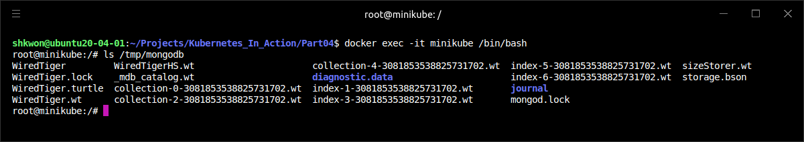
NOTE : Running Minikube with Persistent Volume
The Minikube :
  When you are running Kubernetes cluster with Minikube, the node is inside in the Minikube container. So you want to make a file to be used in Persistent Volume, you need to create a file in the Minikube container.
  In the above screenshot, you can find that the MongoDB files are located in the Minikube container’s “/tmp/mongodb” directory which is used in the previous YAML file.

Slide 25
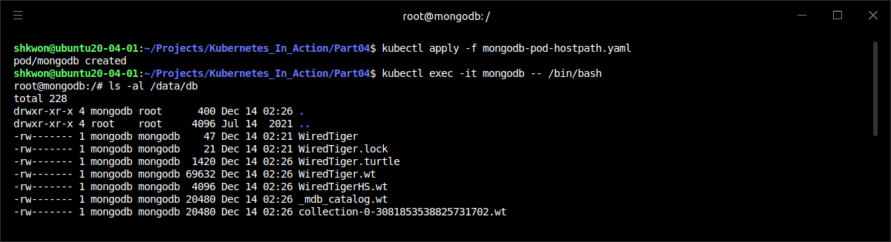
Using Persistent Storage(2/2)
Persistent Storage :
  In previous YAML file, we defined MongoDB pod using hostPath for it’s storage. Create the pod and check it’s storage with the following command.
  NOTICE : When you are running Minikube, your persistent storage will be create in the Minikube container. So you need to run “$ docker exec -it minikube /bin/bash” to check the hostPath. In the above example, you can see the mongodb files in “/tmp/mongodb” directory in the minikube container.
$ kubectl apply -f mongodb-pod-hostpath.yaml
$ kubectl exec -it mongodb -- /bin/bash

Slide 26
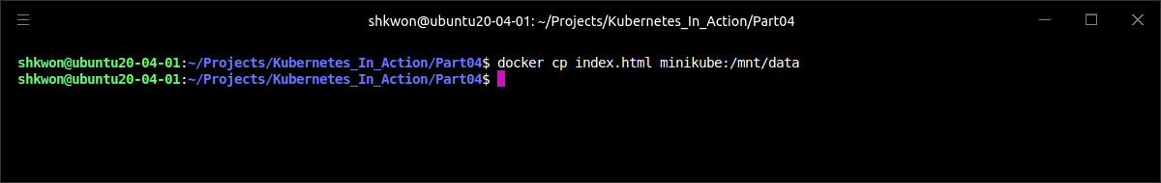
NOTE : Using Minikube with Persistent Volume(1/6)
Minikube Container :
  Before you run some examples, you need to create a file in the Minikube container. To copy host file into container, you can use the following command.
  Then create PersistentVolume with the following YAML file.
$ docker cp [file_name] container:[destination]
apiVersion: v1
kind: PersistentVolume
metadata:
name: task-pv-volume
labels:
type: local
spec:
storageClassName: manual
capacity:
storage: 10Gi
accessModes:
- ReadWriteOnce
hostPath:
path: "/mnt/data"
persistent_volume.yaml

Slide 27
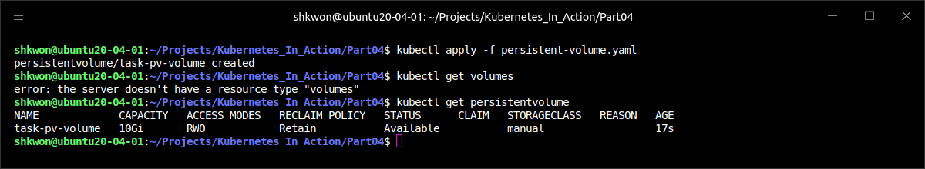
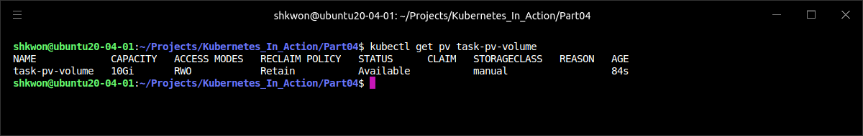
NOTE : Using Minikube with Persistent Volume(2/6)
Persistent Volume Claim :
  The previous configuration file(persistent-volume.yaml) specifies that the volume is at “/home/shkwon/Projects/Kubernetes_In_Action/Part04/data” on the cluster's Node. The configuration also specifies a size of 10 gibibytes and an access mode of “ReadWriteOnce”, which means the volume can be mounted as read-write by a single Node. It defines the StorageClass name “manual” for the PersistentVolume, which will be used to bind PersistentVolumeClaim requests to this PersistentVolume.

Slide 28
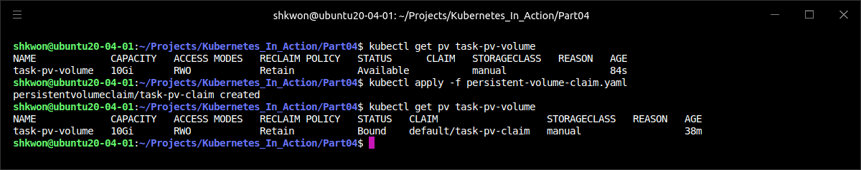
NOTE : Using Minikube with Persistent Volume(3/6)
Creating a PersistentVolumeClaim :
  The next step is to create a PersistentVolumeClaim. Pods use PersistentVolumeClaims to request physical storage. In this exercise, you create a PersistentVolumeClaim that requests a volume of at least three gibibytes that can provide read-write access for at least one Node.
apiVersion: v1
kind: PersistentVolumeClaim
metadata:
name: task-pv-claim
spec:
storageClassName: manual
accessModes:
- ReadWriteOnce
resources:
requests:
storage: 3Gi
persistent-volume-claim.yaml

Slide 29
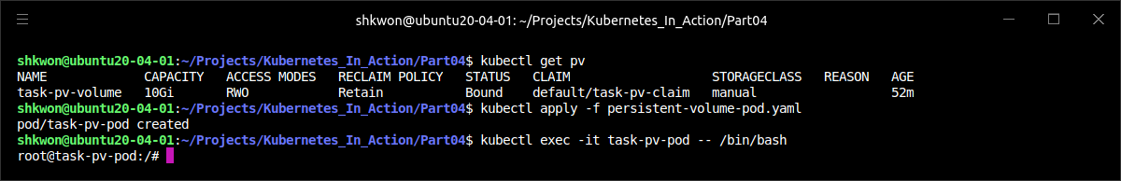
NOTE : Using Minikube with Persistent Volume(4/6)
Creating a Pod :
  The next step is to create a Pod that uses your PersistentVolumeClaim as a volume. Here is the configuration file for the Pod :
apiVersion: v1
kind: Pod
metadata:
name: task-pv-pod
spec:
volumes:
- name: task-pv-storage
persistentVolumeClaim:
claimName: task-pv-claim
containers:
- name: task-pv-container
image: nginx
ports:
- containerPort: 80
name: "http-server"
volumeMounts:
- mountPath: "/usr/share/nginx/html"
name: task-pv-storage
persistent-volume-pod.yaml

Slide 30
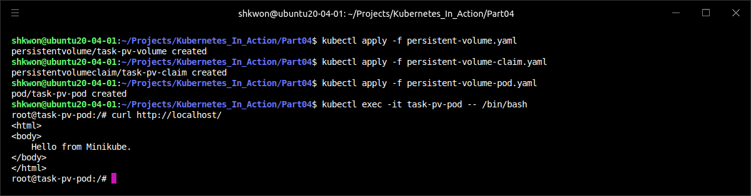
NOTE : Using Minikube with Persistent Volume(5/6)
Accessing the volume :
  Now, you are ready to access the Persistent Volume with the following command. Here we will use “curl” command to see the “index.html” file in the mounted volume.
  NOTE : As you can from the above screenshot, the minikube file(“index.html”) is mounted to the persistent volume.
$ kubectl apply -f persistent-volume.yaml
$ kubectl apply -f persistent-volume-claim.yaml
$ kubectl apply -f persistent-volume-pod.yaml
$ kubectl exec -it task-pv-pod -- /bin/bash
$ curl http://localhost/

Slide 31
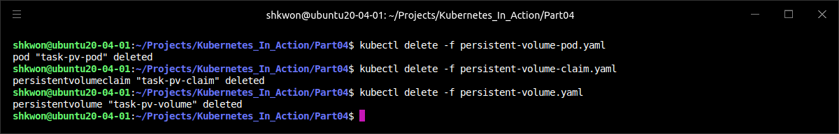
NOTE : Using Minikube with Persistent Volume(6/6)
Remove the Persistent Volume :
  After you finished the test, you can remove the persistent volume with the following commands sequence.
  NOTE : For more information, please see “https://kubernetes.io/docs/tasks/configure-pod-container/configure-persistent-volume-storage/”
$ kubectl delete -f persistent-volume-pod.yaml
$ kubectl delete -f persistent-volume-claim.yaml
$ kubectl delete -f persistent-volume.yaml

Slide 32
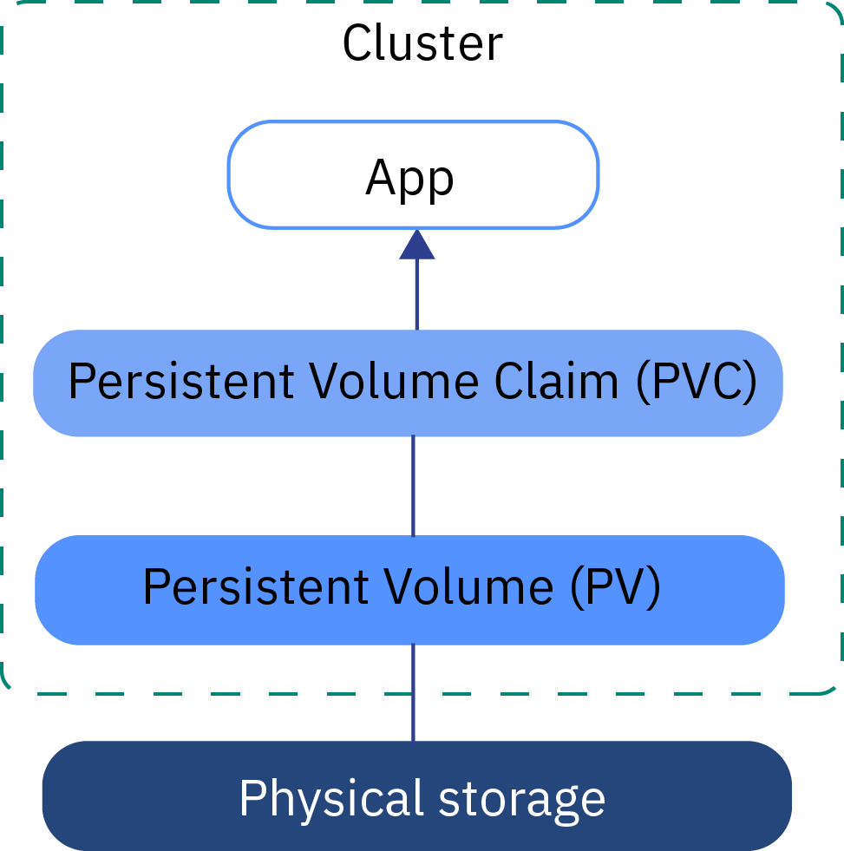
Decoupling Pods from the Underlying Storage Technology(1/25)
Hiding the Actual Infrastructure :
  All the persistent volume types we’ve explored so far have required the developer of the pod to have knowledge of the actual network storage infrastructure available in the cluster. For example, to create a NFS-backed volume, the developer has to know the actual server the NFS export is located on. This is against the basic idea of Kubernetes, which aims to hide the actual infrastructure from both the application and its developer, leaving them free from worrying about the specifics of the infrastructure and making apps portable across a wide array of cloud providers and on-premises datacenters.
  Ideally, a developer deploying their apps on Kubernetes should never have to know what kind of storage technology is used underneath, the same way they don’t have to know what type of physical servers are being used to run their pods. Infrastructure-related dealings should be the sole domain of the cluster administrator.
  When a developer needs a certain amount of persistent storage for their application, they can request it from Kubernetes, the same way they can request CPU, memory, and other resources when creating a pod. The system administrator can configure the cluster so it can give the apps what they request.

Slide 33
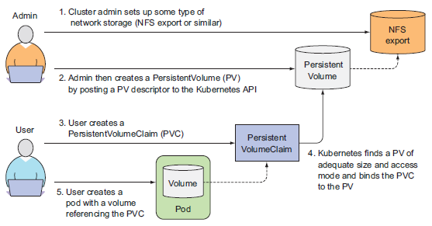
Decoupling Pods from the Underlying Storage Technology(2/25)
PersistentVolumes and PersistentVolumeClaims :
  To enable apps to request storage in a Kubernetes cluster without having to deal with infrastructure specifics, two new resources were introduced. They are PersistentVolumes and PersistentVolumeClaims. The names may be a bit misleading, because as you’ve seen in the previous few sections, even regular Kubernetes volumes can be used to store persistent data.
  Using a PersistentVolume inside a pod is a little more complex than using a regular pod volume, so let’s illustrate how pods, PersistentVolumeClaims, PersistentVolumes, and the actual underlying storage relate to each other in the following figure.

Slide 34
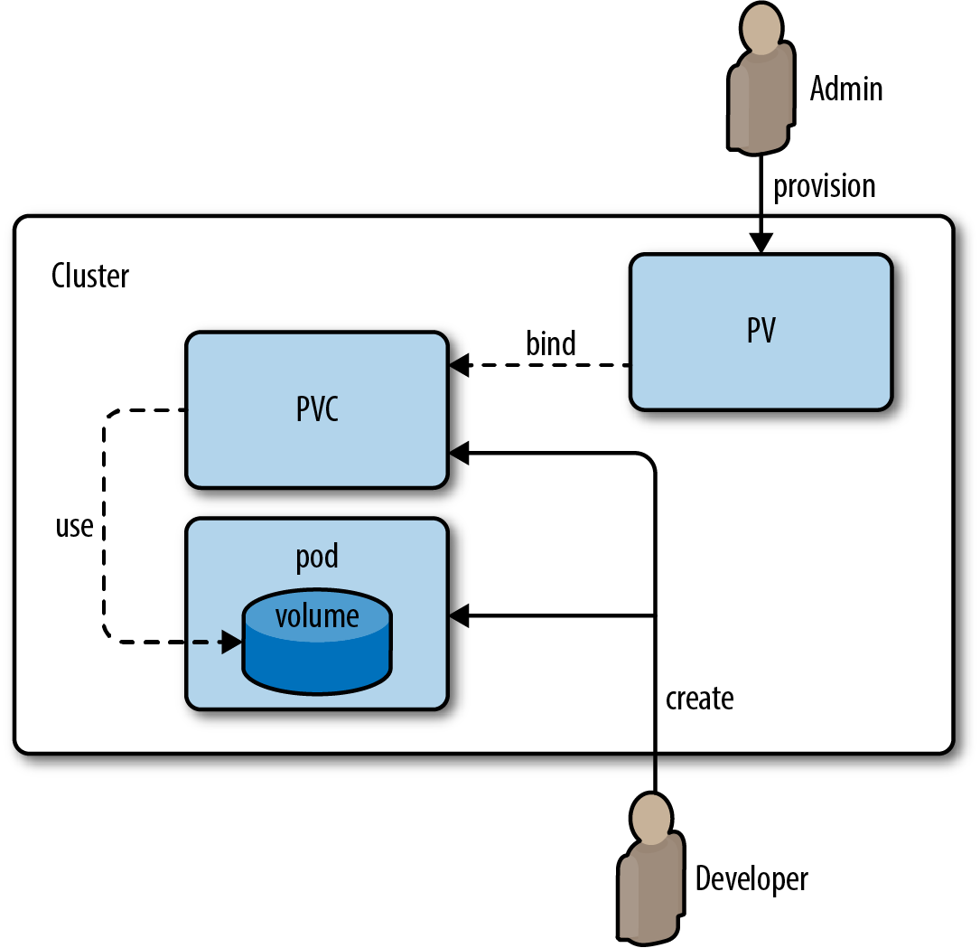
Decoupling Pods from the Underlying Storage Technology(3/25)
PersistentVolumes and PersistentVolumeClaims :
  Instead of the developer adding a technology-specific volume to their pod, it’s the cluster administrator who sets up the underlying storage and then registers it in Kubernetes by creating a PersistentVolume resource through the Kubernetes API server. When creating the PersistentVolume, the admin specifies its size and the access modes it supports.
  When a cluster user needs to use persistent storage in one of their pods, they first create a PersistentVolumeClaim manifest, specifying the minimum size and the access mode they require. The user then submits the PersistentVolumeClaim manifest to the Kubernetes API server, and Kubernetes finds the appropriate PersistentVolume and binds the volume to the claim. The PersistentVolumeClaim can then be used as one of the volumes inside a pod. Other users cannot use the same PersistentVolume until it has been released by deleting the bound PersistentVolumeClaim.

Slide 35
Decoupling Pods from the Underlying Storage Technology(4/25)
Creating a PersistentVolume :
  Let’s revisit the MongoDB example, but unlike before, you won’t reference the Persistent Disk in the pod directly. Instead, you’ll first assume the role of a cluster administrator and create a PersistentVolume backed by the host(minikube) Persistent Disk. Then you’ll assume the role of the application developer and first claim the PersistentVolume and then use it inside your pod.
  All you need to do is create the PersistentVolume resource in Kubernetes by preparing the manifest shown in the following listing and posting it to the API server.
  When creating a PersistentVolume, the administrator needs to tell Kubernetes what its capacity is and whether it can be read from and/or written to by a single node or by multiple nodes at the same time. They also need to tell Kubernetes what to do with the PersistentVolume when it’s released (when the PersistentVolumeClaim it’s bound to is deleted). And last, but certainly not least, they need to specify the type, location, and other properties of the actual storage this PersistentVolume is backed by.
apiVersion: v1
kind: PersistentVolume
metadata:
name: mongodb-pv
spec:
capacity:
storage: 1Gi
accessModes:
- ReadWriteOnce
- ReadOnlyMany
persistentVolumeReclaimPolicy: Retain
hostPath:
path: /tmp/mongodb
mongodb-pv-hostpath.yaml

Slide 36
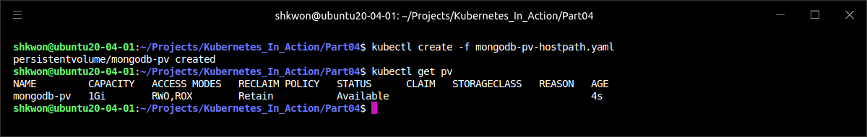
Decoupling Pods from the Underlying Storage Technology(5/25)
Creating a PersistentVolume :
  After you create the PersistentVolume with the “kubectl create” command, it should be ready to be claimed. See if it is by listing all PersistentVolumes :
  NOTE : “pv” is used as a shorthand for “persistentvolume”. As expected, the PersistentVolume is shown as Available, because you haven’t yet created the PersistentVolumeClaim.
$ kubectl create -f mongodb-pv-hostpath.yaml
$ kubectl get pv

Slide 37
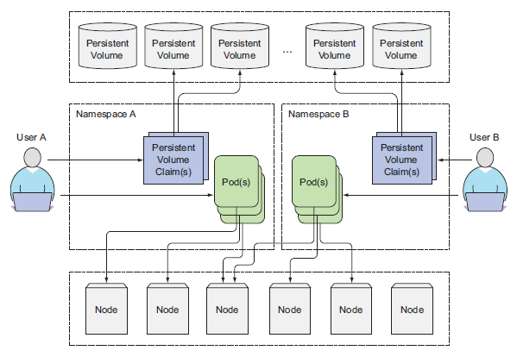
Decoupling Pods from the Underlying Storage Technology(6/25)
Creating a PersistentVolume :
  As you can see in the following figure, the PersistenVolumes are cluster-level resources like nodes.

Slide 38
Decoupling Pods from the Underlying Storage Technology(7/25)
Claiming a PersistentVolume by Creating a PersistentVolumeClaim :
  Assume that you need to deploy a pod that requires persistent storage. You’ll use the PersistentVolume you created earlier. But you can’t use it directly in the pod. You need to claim it first.
  Claiming a PersistentVolume is a completely separate process from creating a pod, because you want the same PersistentVolumeClaim to stay available even if the pod is rescheduled (remember, rescheduling means the previous pod is deleted and a new one is created).
  You’ll create the claim now. You need to prepare a PersistentVolumeClaim manifest like the one shown in the following listing and post it to the Kubernetes API through “kubectl create” command.
  As soon as you create the claim, Kubernetes finds the appropriate PersistentVolume and binds it to the claim. The PersistentVolume’s capacity must be large enough to accommodate what the claim requests. Additionally, the volume’s access modes must include the access modes requested by the claim. In this case, the claim requests 1 GiB of storage and a ReadWriteOnce access mode. The PersistentVolume we created earlier matches those two requirements so it is bound to our claim.
apiVersion: v1
kind: PersistentVolumeClaim
metadata:
name: mongodb-pvc
spec:
resources:
requests:
storage: 1Gi
accessModes:
- ReadWriteOnce
storageClassName: ""
mongodb-pvc.yaml

Slide 39
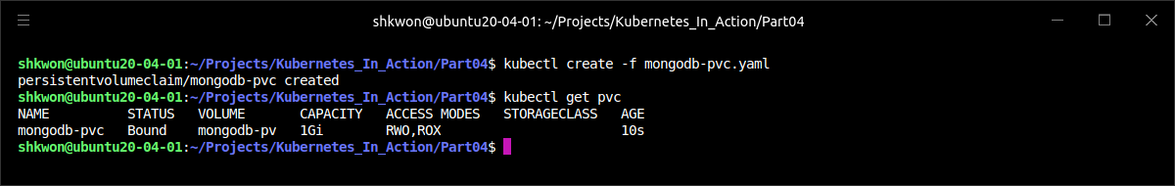
Decoupling Pods from the Underlying Storage Technology(8/25)
Binding and Listing PersistentVolumeClaims :
  List all PersistentVolumeClaims to see the state of your PVC with the following commands.
  NOTE : We’re using “pvc” as a shorthand for persistentvolumeclaim.
  The claim is shown as “Bound” to PersistentVolume “mongodb-pv”.
  NOTE : The abbreviations used for the access modes :
    RWO—ReadWriteOnce—Only a single node can mount the volume for reading and writing.
    ROX—ReadOnlyMany—Multiple nodes can mount the volume for reading.
    RWX—ReadWriteMany—Multiple nodes can mount the volume for both reading and writing.
  NOTE : RWO, ROX, and RWX pertain to the number of worker nodes that can use the volume at the same time, not to the number of pods!
$ kubectl create -f mongodb-pvc.yaml
$ kubectl get pvc

Slide 40
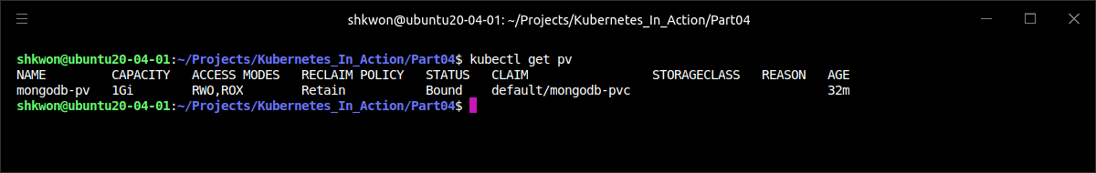
Decoupling Pods from the Underlying Storage Technology(9/25)
Listing PersistentVolumes :
  You can also see that the PersistentVolume is now Bound and no longer Available by inspecting it with “kubectl get” :
  The PersistentVolume shows it’s bound to claim “default/mongodb-pvc”. The “default” part is the namespace the claim resides in (you created the claim in the default namespace). We’ve already said that PersistentVolume resources are cluster-scoped and thus cannot be created in a specific namespace, but PersistentVolumeClaims can only be created in a specific namespace. They can then only be used by pods in the same namespace.
$ kubectl get pv

Slide 41
Decoupling Pods from the Underlying Storage Technology(10/25)
Using a PersistentVolumeClaim in a Pod :
  The PersistentVolume is now yours to use. Nobody else can claim the same volume until you release it. To use it inside a pod, you need to reference the PersistentVolumeClaim by name inside the pod’s volume as shown in the following listing.
  NOTICE : If you use the “mongo” image without any version tag, the container will crash. Because MongoDB v5.0+ requires a CPU with AVX support, we will use “mongo:4.4.6” image in this case.
apiVersion: v1
kind: Pod
metadata:
name: mongodb
spec:
containers:
- image: mongo:4.4.6
name: mongodb
volumeMounts:
- name: mongodb-data
mountPath: /data/db
ports:
- containerPort: 27017
protocol: TCP
volumes:
- name: mongodb-data
persistentVolumeClaim:
claimName: mongodb-pvc
mongodb-pod-pvc.yaml

Slide 42
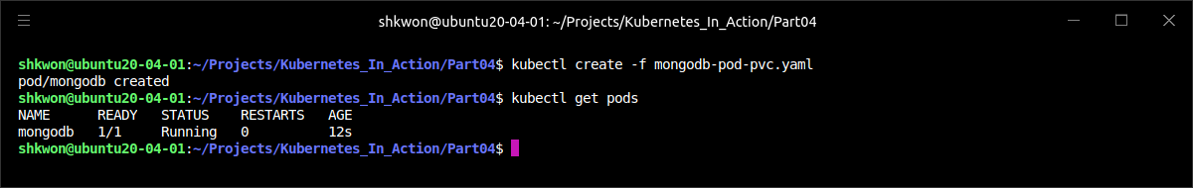
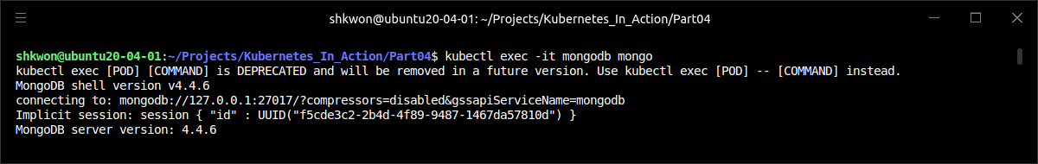
Decoupling Pods from the Underlying Storage Technology(11/25)
Using a PersistentVolumeClaim in a Pod :
  Use the “$ kubectl create -f” command to create the Pod and try to access the DB with interactive terminal.
  NOTE : To exit from the MongoDB command line, just enter “exit”.
$ kubectl create -f mongodb-pod-pvc.yaml

Slide 43
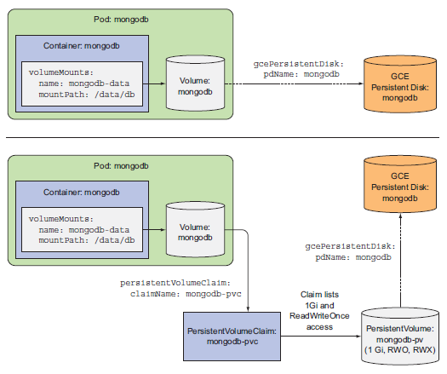
Decoupling Pods from the Underlying Storage Technology(12/25)
Understanding the Benefits of Using PersistentVolumes and Claims :
  The following figure shows both ways a pod can use a GCE Persistent Disk—directly or through a PersistentVolume and claim. Consider how using this indirect method of obtaining storage from the infrastructure is much simpler for the application developer (or cluster user). Yes, it does require the additional steps of creating the PersistentVolume and the PersistentVolumeClaim, but the developer doesn’t have to know anything about the actual storage technology used underneath.
  Additionally, the same pod and claim manifests can now be used on many different Kubernetes clusters, because they don’t refer to anything infrastructure-specific. The claim states, “I need x amount of storage and I need to be able to read and write to it by a single client at once,” and then the pod references the claim by name in one of its volumes.

Slide 44
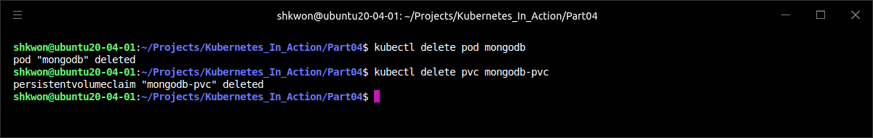
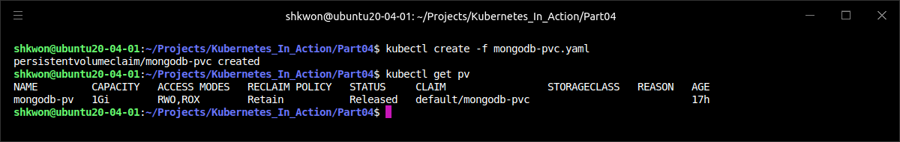
Decoupling Pods from the Underlying Storage Technology(13/25)
Recycling PersistentVolumes :
  Delete the pod and the PersistentVolumeClaim :
  What if you create the PersistentVolumeClaim again? Will it be bound to the PersistentVolume or not? After you create the claim, what does “$ kubectl get pv” show?
  The STATUS column shows the PersistentVolume as “Released”, not Available like before. Because you’ve already used the volume, it may contain data and shouldn’t be bound to a completely new claim without giving the cluster admin a chance to clean it up. Without this, a new pod using the same PersistentVolume could read the data stored there by the previous pod, even if the claim and pod were created in a different namespace (and thus likely belong to a different cluster tenant).

Slide 45
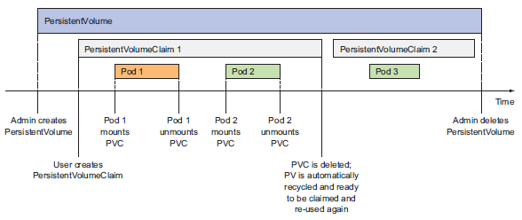
Decoupling Pods from the Underlying Storage Technology(14/25)
Reclaiming PersistentVolumes Manually and Automatically :
  You told Kubernetes you wanted your PersistentVolume to behave like this when you created it—by setting its “persistentVolumeReclaimPolicy” to “Retain”. You wanted Kubernetes to retain the volume and its contents after it’s released from its claim. The only way to manually recycle the PersistentVolume to make it available again is to delete and recreate the PersistentVolume resource. As you do that, it’s your decision what to do with the files on the underlying storage : you can either delete them or leave them alone so they can be reused by the next pod.
  Two other possible reclaim policies exist: “Recycle” and “Delete”. The Recycle policy deletes the volume’s contents and makes the volume available to be claimed again. This way, the PersistentVolume can be reused multiple times by different PersistentVolumeClaims and different pods, as you can see in the following figure. The Delete policy, on the other hand, deletes the underlying storage.

Slide 46
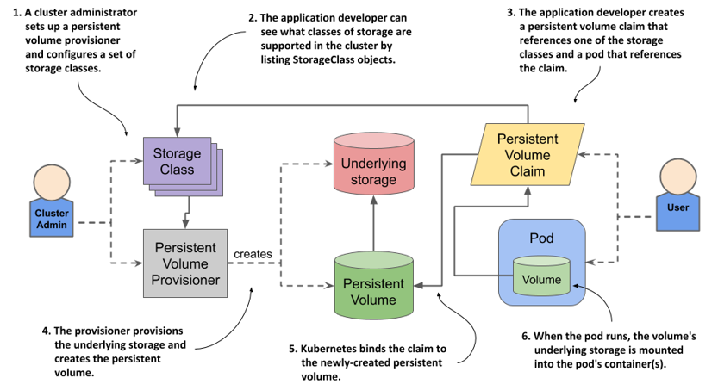
Decoupling Pods from the Underlying Storage Technology(15/25)
Reclaiming PersistentVolumes Manually and Automatically :
  NOTE : The Recycle option is currently not available for GCE Persistent Disks. This type of A PersistentVolume only supports the Retain or Delete policies. Other PersistentVolume types may or may not support each of these options, so before creating your own PersistentVolume, be sure to check what reclaim policies are supported for the specific underlying storage you’ll use in the volume.
  TIP : You can change the PersistentVolume reclaim policy on an existing PersistentVolume. For example, if it’s initially set to Delete, you can easily change it to Retain to prevent losing valuable data.

Slide 47
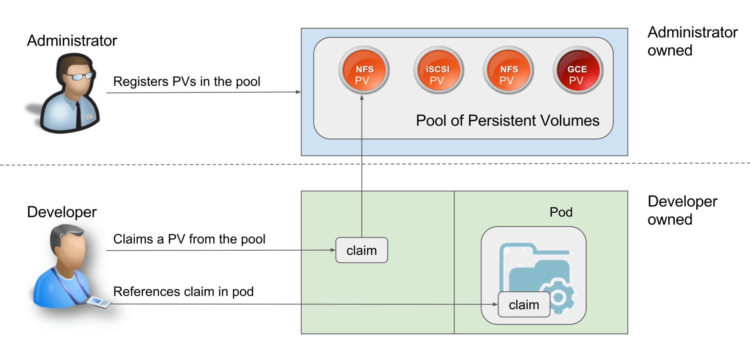
Decoupling Pods from the Underlying Storage Technology(16/25)
Dynamic Provisioning of PersistentVolumes :
  You’ve seen how using PersistentVolumes and PersistentVolumeClaims makes it easy to obtain persistent storage without the developer having to deal with the actual storage technology used underneath. But this still requires a cluster administrator to provision the actual storage up front. Luckily, Kubernetes can also perform this job automatically through dynamic provisioning of PersistentVolumes.
  The cluster admin, instead of creating PersistentVolumes, can deploy a PersistentVolume provisioner and define one or more StorageClass objects to let users choose what type of PersistentVolume they want. The users can refer to the StorageClass in their PersistentVolumeClaims and the provisioner will take that into account when provisioning the persistent storage.
  NOTE : Similar to PersistentVolumes, StorageClass resources aren’t namespaced. Kubernetes includes provisioners for the most popular cloud providers, so the administrator doesn’t always need to deploy a provisioner. But if Kubernetes is deployed on-premises, a custom provisioner needs to be deployed.
  Instead of the administrator pre-provisioning a bunch of PersistentVolumes, they need to define one or two (or more) StorageClasses and let the system create a new PersistentVolume each time one is requested through a PersistentVolumeClaim. The great thing about this is that it’s impossible to run out of PersistentVolumes (obviously, you can run out of storage space).

Slide 48
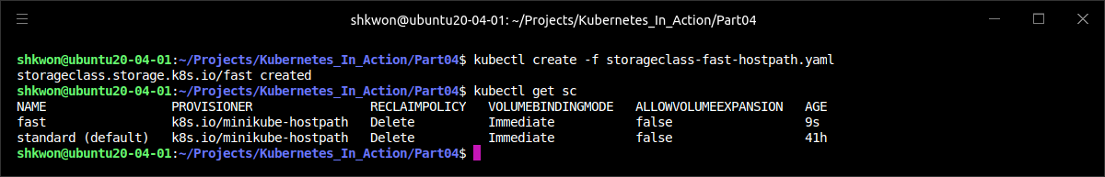
Decoupling Pods from the Underlying Storage Technology(17/25)
Defining the Available Storage Types through StorageClass Resources :
  Before a user can create a PersistentVolumeClaim, which will result in a new PersistentVolume being provisioned, an admin needs to create one or more StorageClass resources.
  The StorageClass resource specifies which provisioner should be used for provisioning the PersistentVolume when a PersistentVolumeClaim requests this StorageClass. The parameters defined in the StorageClass definition are passed to the provisioner and are specific to each provisioner plugin.
  NOTE : In the above YAML file, “pd” means Persistent Disk.
apiVersion: storage.k8s.io/v1
kind: StorageClass
metadata:
name: fast
provisioner: k8s.io/minikube-hostpath
parameters:
type: pd-ssd
storageclass-fast-hostpath.yaml

Slide 49
Decoupling Pods from the Underlying Storage Technology(18/25)
Requesting the Storage Class in a PersistentVolumeClaim :
  After the StorageClass resource is created, users can refer to the storage class by name in their PersistentVolumeClaims. You can modify your “mongodb-pvc” to use dynamic provisioning. The following listing shows the updated YAML definition of the PVC.
  Apart from specifying the size and access modes, your PersistentVolumeClaim now also specifies the class of storage you want to use. When you create the claim, the PersistentVolume is created by the provisioner referenced in the fast StorageClass resource. The provisioner is used even if an existing manually provisioned PersistentVolume matches the PersistentVolumeClaim.
  NOTE : If you reference a non-existing storage class in a PVC, the provisioning of the PV will fail (you’ll see a “ProvisioningFailed” event when you use “$ kubectl describe” command on the PVC).
apiVersion: v1
kind: PersistentVolumeClaim
metadata:
name: mongodb-pvc
spec:
storageClassName: fast
resources:
requests:
storage: 100Mi
accessModes:
- ReadWriteOnce
mongodb-pvc-dp.yaml

Slide 50
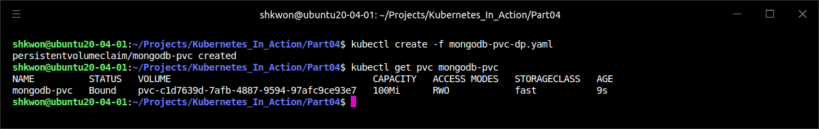
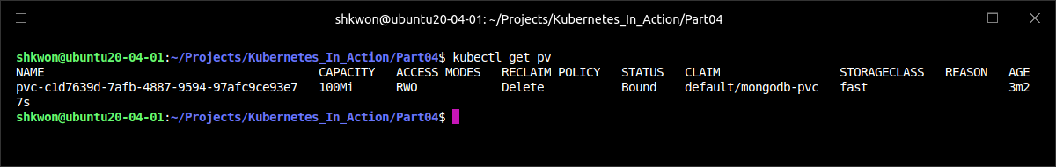
Decoupling Pods from the Underlying Storage Technology(19/25)
Examining the Created PVC and the Dynamically Provisioned PV :
  To use the previous dynamically provisioned PV, you’ll create the PVC and then use “$ kubectl get” command to see it :
  The VOLUME column shows the PersistentVolume that’s bound to this claim (the actual name is longer than what’s shown above). You can try listing PersistentVolumes now using “$ kubectl get pv” command to see that a new PV has indeed been created automatically :
$ kubectl get pvc mongodb-pvc

Slide 51
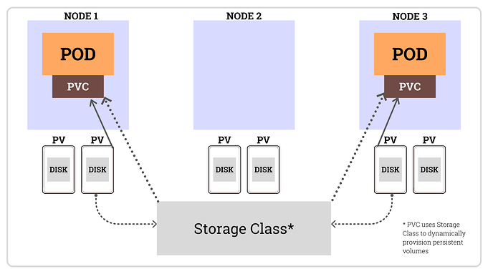
Decoupling Pods from the Underlying Storage Technology(20/25)
Understanding How to Use Storage Classes :
  The cluster admin can create multiple storage classes with different performance or other characteristics. The developer then decides which one is most appropriate for each claim they create.
  The nice thing about StorageClasses is the fact that claims refer to them by name. The PVC definitions are therefore portable across different clusters, as long as the StorageClass names are the same across all of them. For example, as a cluster admin, you’ll have to create a different storage class (but with the same name). The storage class defined in the “storageclass-fast-hostpath.yaml” file is tailor-made for use in Minikube or GKE. Then, once you deploy the storage class, you as a cluster user can deploy the exact same PVC manifest and the exact same pod manifest as before. This shows how the pods and PVCs are portable across different clusters.

Slide 52
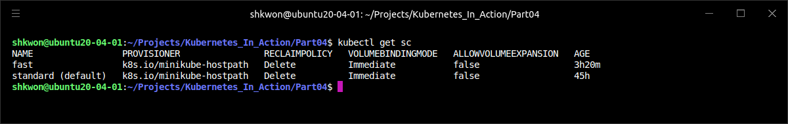
Decoupling Pods from the Underlying Storage Technology(21/25)
Dynamic Provisioning without Specifying a Storage Class :
  Here we can understand that provisioning of storage has evolved from early Kubernetes versions to now. Now it’s time see that the latest and simplest way of attaching a PersistentVolume to a pod.
  When you created your custom storage class called “fast”, you didn’t check if any existing storage classes were already defined in your cluster. You can use “$ kubectl get sc” command to see which storage classes are available.
  NOTE : We’re using “sc” as shorthand for storageclass.
  Beside the fast storage class, which you created yourself, a standard storage class exists and is marked as “default”.

Slide 53
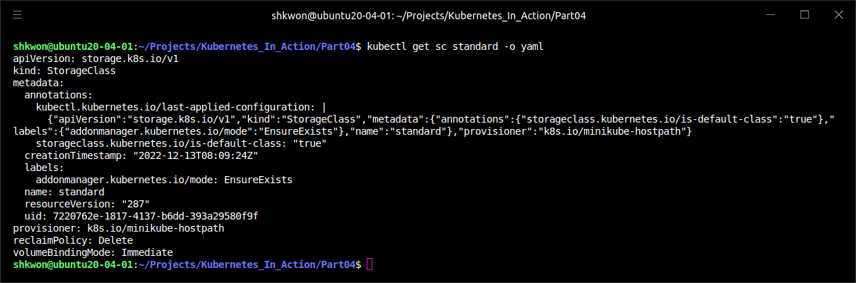
Decoupling Pods from the Underlying Storage Technology(22/25)
Dynamic Provisioning without Specifying a Storage Class :
  You’re going to use “$ kubectl get” command to see more info about the standard storage class in a Minikube cluster, as shown in the following listing.
  If you look closely toward the top of the listing, the storage class definition includes an annotation, which makes this the default storage class. The default storage class is what’s used to dynamically provision a PersistentVolume if the PersistentVolumeClaim doesn’t explicitly say which storage class to use.
$ kubectl get sc standard -o yaml

Slide 54
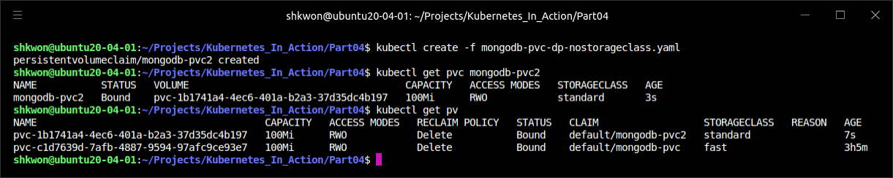
Decoupling Pods from the Underlying Storage Technology(23/25)
Dynamic Provisioning without Specifying a Storage Class :
  You can create a PVC without specifying the “storageClassName” attribute and (on Google Kubernetes Engine) a “GCE Persistent Disk” of type “pd-standard” will be provisioned for you. Try this by creating a claim from the YAML in the following listing.
  The above PVC definition includes only the storage size request and the desired access modes, but no storage class. When you create the PVC, whatever storage class is marked as “default” will be used.
apiVersion: v1
kind: PersistentVolumeClaim
metadata:
name: mongodb-pvc2
spec:
resources:
requests:
storage: 100Mi
accessModes:
- ReadWriteOnce
mongodb-pvc-dp-nostorageclass.yaml

Slide 55
Decoupling Pods from the Underlying Storage Technology(24/25)
Dynamic Provisioning without Specifying a Storage Class :
  Let’s repeat the relevant lines of the “mongodb-pvc.yaml” PVC definition here :
  NOTE : Specifying an empty string as the storage class name ensures the PVC binds to a pre-provisioned PV instead of dynamically provisioning a new one.
  If you hadn’t set the “storageClassName” attribute to an empty string, the dynamic volume provisioner would have provisioned a new PersistentVolume, despite there being an appropriate pre-provisioned PersistentVolume.
  TIP : Explicitly set “storageClassName” to "" if you want the PVC to use a pre-provisioned PersistentVolume.
apiVersion: v1
kind: PersistentVolumeClaim
metadata:
name: mongodb-pvc
spec:
resources:
requests:
storage: 1Gi
accessModes:
- ReadWriteOnce
storageClassName: ""
mongodb-pvc.yaml

Slide 56

Decoupling Pods from the Underlying Storage Technology(25/25)
Dynamic Provisioning without Specifying a Storage Class :
  To summarize, the best way to attach persistent storage to a pod is to only create the PVC (with an explicitly specified storageClassName if necessary) and the pod (which refers to the PVC by name). Everything else is taken care of by the dynamic PersistentVolume provisioner. The following figure will show you how to do it.

Slide 57
ConfigMaps and Secrets
Configuring Applications

Slide 58

Configuring Containerized Applications(1/2)
How to Configure Your Application :
  If you skip the fact that you can bake the configuration into the application itself, when starting development of a new app, you usually start off by having the app configured through command-line arguments. Then, as the list of configuration options grows, you can move the configuration into a config file.
  Another way of passing configuration options to an application that’s widely popular in containerized applications is through environment variables. Instead of having the app read a config file or command-line arguments, the app looks up the value of a certain environment variable. The official MySQL container image, for example, uses an environment variable called “MYSQL_ROOT_PASSWORD” for setting the password for the root super-user account.
  Using configuration files inside Docker containers is a bit tricky, because you’d have to bake the config file into the container image itself or mount a volume containing the file into the container. Obviously, baking files into the image is similar to hardcoding configuration into the source code of the application, because it requires you to rebuild the image every time you want to change the config. Plus, everyone with access to the image can see the config, including any information that should be kept secret, such as credentials or encryption keys. Using a volume is better, but still requires you to make sure the file is written to the volume before the container is started.

Slide 59

Configuring Containerized Applications(2/2)
The ConfigMap and Secret :
  A simpler way allows you to put the configuration data into a top-level Kubernetes resource and store it and all the other resource definitions in the same Git repository or in any other file-based storage. The Kubernetes resource for storing configuration data is called a ConfigMap.
  Regardless if you’re using a ConfigMap to store configuration data or not, you can configure your apps by
    Passing command-line arguments to containers
    Setting custom environment variables for each container
    Mounting configuration files into containers through a special type of volume
  Though most configuration options don’t contain any sensitive information, several can. These include credentials, private encryption keys, and similar data that needs to be kept secure. This type of information needs to be handled with special care, which is why Kubernetes offers another type of first-class object called a Secret.

Slide 60
Passing Command-Line Arguments to Containers(1/10)
Defining the Command and Arguments in Docker :
  Kubernetes allows overriding the command as part of the pod’s container definition when you want to run a different executable instead of the one specified in the image, or want to run it with a different set of command-line arguments. The whole command that gets executed in the container is composed of two parts : the command and the arguments.
  In a Dockerfile, two instructions define the two parts :
    ENTRYPOINT defines the executable invoked when the container is started.
    CMD specifies the arguments that get passed to the ENTRYPOINT.
  Although you can use the CMD instruction to specify the command you want to execute when the image is run, the correct way is to do it through the ENTRYPOINT instruction and to only specify the CMD if you want to define the default arguments. The image can then be run without specifying any arguments
  or with additional arguments, which override whatever’s set under CMD in the Dockerfile :
$ docker run <image>
$ docker run <image> <arguments>

Slide 61


Passing Command-Line Arguments to Containers(2/10)
Defining the Command and Arguments in Docker :
  Both instructions support two different forms :
    shell form—For example, ENTRYPOINT node app.js.
    exec form—For example, ENTRYPOINT ["node", "app.js"].
  The difference is whether the specified command is invoked inside a shell or not.
  In the “kubia” image you created before, you used the “exec” form of the ENTRYPOINT instruction :
  This runs the node process directly (not inside a shell), as you can see by listing the processes running inside the container :
ENTRYPOINT ["node", "app.js"]

Slide 62

Passing Command-Line Arguments to Containers(3/10)
Defining the Command and Arguments in Docker :
  If you’d used the shell form (“ENTRYPOINT node app.js”), these would have been the container’s processes :
$ docker exec -it <container id> ps x

Slide 63
Passing Command-Line Arguments to Containers(4/10)
Defining the Command and Arguments in Docker :
  Let’s modify your fortune script and image so the delay interval in the loop is configurable. You’ll add an “INTERVAL” variable and initialize it with the value of the first command-line argument, as shown in the following listing.
  Now, you’ll modify the Dockerfile so it uses the exec version of the ENTRYPOINT instruction and sets the default interval to 10 seconds using the CMD instruction, as shown in the following listing.
  NOTICE : You need to change the file mode using “chmod 0777 fortuneloop.sh” command before you build docker image.
fortune-args/fortuneloop.sh
#!/bin/bash
trap "exit" SIGINT
INTERVAL=$1
echo Configured to generate new fortune every $INTERVAL seconds
mkdir -p /var/htdocs
while :
do
echo $(date) Writing fortune to /var/htdocs/index.html
/usr/games/fortune > /var/htdocs/index.html
sleep $INTERVAL
done
FROM ubuntu:20.04
RUN apt-get update ; apt-get -y install fortune apt-utils
ADD fortuneloop.sh /bin/fortuneloop.sh
ENTRYPOINT ["/bin/fortuneloop.sh"]
CMD ["10"]
fortune-args/Dockerfile

Slide 64



Passing Command-Line Arguments to Containers(5/10)
Defining the Command and Arguments in Docker :
  You can now build and push the image to Docker Hub. This time, you’ll tag the image as args :
$ docker build -t knix008/fortune:args .
$ docker push knix008/fortune:args

Slide 65

NOTE : Docker Hub Repository
Checking Your Docker Hub Repository :
  As you can see from the following screenshot, you can find that the “knix008/fortune:args” image now.

Slide 66


Passing Command-Line Arguments to Containers(6/10)
Defining the Command and Arguments in Docker :
  You can test the image by running it locally with Docker :
  Now you can override the default sleep interval by passing it as an argument :
$ docker run -it knix008/fortune:args
$ docker run -it knix008/fortune:args 15

Slide 67

Passing Command-Line Arguments to Containers(7/10)
Overriding the Command and Arguments in Kubernetes :
  In Kubernetes, when specifying a container, you can choose to override both ENTRYPOINT and CMD. To do that, you set the properties “command” and “args” in the container specification, as shown in the following listing.
  In most cases, you’ll only set custom arguments and rarely override the command (except in general-purpose images such as busybox, which doesn’t define an ENTRYPOINT at all).
  NOTE : The “command” and “args” fields can’t be updated after the pod is created.
apiVersion: v1
kind: Pod
metadata:
name: fortune-args
spec:
containers:
- name: fortune-args
image: knix008/fortune:args
command: ["/bin/fortuneloop.sh"]
args: ["10"]
fortune-pod-args.yaml

Slide 68

Passing Command-Line Arguments to Containers(8/10)
Overriding the Command and Arguments in Kubernetes :
  The two Dockerfile instructions and the equivalent pod spec fields are shown in the following table.

Slide 69
Passing Command-Line Arguments to Containers(9/10)
Overriding the Command and Arguments in Kubernetes :
  To run the fortune pod with a custom delay interval, you’ll copy your “fortune-pod.yaml” into “fortune-pod-command-args.yaml” and modify it as shown in the following listing.
  NOTE : You added the “args” array to the container definition. The values of the array will be passed to the container as command-line arguments when it is run.
apiVersion: v1
kind: Pod
metadata:
name: fortune15s
spec:
containers:
- image: knix008/fortune:args
args: ["15"]
name: html-generator
volumeMounts:
- name: html
mountPath: /var/htdocs
- image: nginx:alpine
name: web-server
volumeMounts:
- name: html
mountPath: /usr/share/nginx/html
readOnly: true
ports:
- containerPort: 80
protocol: TCP
volumes:
- name: html
emptyDir: {}
fortune-pod-command-args.yaml

Slide 70

Passing Command-Line Arguments to Containers(10/10)
Overriding the Command and Arguments in Kubernetes :
  The array notation used in the previous listing is great if you have one argument or a few. If you have several, you can also use the following notation:
  TIP : You don’t need to enclose string values in quotations marks (but you must enclose numbers).
  Specifying arguments is one way of passing config options to your containers through command-line arguments.
args:
- foo
- bar
- "15"

Slide 71

Setting Environment Variables for a Container(1/6)
Environment Variables :
  The containerized applications often use environment variables as a source of configuration options. Kubernetes allows you to specify a custom list of environment variables for each container of a pod, as shown in the following figure. Although it would be useful to also define environment variables at the pod level and have them be inherited by its containers, no such option currently exists.
  NOTE : Like the container’s command and arguments, the list of environment variables also cannot be updated after the pod is created.

Slide 72
Setting Environment Variables for a Container(2/6)
Configuring through an Environment Variable :
  Let’s see how to modify your “fortuneloop.sh” script once again to allow it to be configured from an environment variable, as shown in the following listing.
  All you had to do was remove the row where the INTERVAL variable is initialized. Because your “app” is a simple bash script, you didn’t need to do anything else. If the app was written in Java you’d use “System.getenv("INTERVAL")”, whereas in Node.JS you’d use “process.env.INTERVAL”, and in Python you’d use “os.environ['INTERVAL’]”.
  NOTE : You need to change the permission of the “fortuneloop.sh” using “$ chmod 0777 fortuneloop.sh” command.
#!/bin/bash
trap "exit" SIGINT
echo Configured to generate new fortune every $INTERVAL seconds
mkdir -p /var/htdocs
while :; do
echo $(date) Writing fortune to /var/htdocs/index.html
/usr/games/fortune >/var/htdocs/index.html
sleep $INTERVAL
done
fortune-env/fortuneloop.sh

Slide 73
Setting Environment Variables for a Container(3/6)
Specifying Environment Variables in a Container Definition :
  After building the new image (we can tag it as “knix008/fortune:env” for this example) and pushing it to Docker Hub, you can run it by creating a new pod, in which you pass the environment variable to the script by including it in your container definition, as shown in the following listing.
apiVersion: v1
kind: Pod
metadata:
name: fortune-env
spec:
containers:
- image: knix008/fortune:env
env:
- name: INTERVAL
value: “10”
name: html-generator
volumeMounts:
- name: html
mountPath: /var/htdocs
- image: nginx:alpine
name: web-server
volumeMounts:
- name: html
mountPath: /usr/share/nginx/html
readOnly: true
ports:
- containerPort: 80
protocol: TCP
volumes:
- name: html
emptyDir: {}
fortune-pod-env.yaml

Slide 74

Setting Environment Variables for a Container(4/6)
Specifying Environment Variables in a Container Definition :
  To make the docker container image and push it into the Docker hub, you need to run the following commands.
$ chmod 0777 fortuneloop.sh
$ docker build -t knix008/fortune:env .
$ docker push knix008/fortune:env

Slide 75

Setting Environment Variables for a Container(5/6)
Specifying Environment Variables in a Container Definition :
  NOTE : You set the environment variable inside the container definition, not at the pod level.
  NOTE : Don’t forget that in each container, Kubernetes also automatically exposes environment variables for each service in the same namespace. These environment variables are basically auto-injected configuration.
$ kubectl create -f fortune-pod-env.yaml
$ kubectl get pods
$ kubectl logs fortune-env

Slide 76
Setting Environment Variables for a Container(6/6)
Referring to Other Environment Variables in a Variable’s Value :
  In the previous example, you set a fixed value for the environment variable, but you can also reference previously defined environment variables or any other existing variables by using the “$(VAR)” syntax. If you define two environment variables, the second one can include the value of the first one as shown in the following listing.
  In this case, the “SECOND_VAR”’s value will be "foobar". Similarly, both the “command” and “args” attributes can also refer to environment variables like this.
  Having values effectively hardcoded in the pod definition means you need to have separate pod definitions for your production and your development pods. To reuse the same pod definition in multiple environments, it makes sense to decouple the configuration from the pod descriptor. Luckily, you can do that using a “ConfigMap” resource and using it as a source for environment variable values using the “valueFrom” instead of the “value” field.
…
env:
- name: FIRST_VAR
value: "foo"
- name: SECOND_VAR
value: "$(FIRST_VAR)bar“
…

Slide 77
Decoupling Configuration with a ConfigMap(1/31)
Introducing ConfigMaps :
  The whole point of an app’s configuration is to keep the config options that vary between environments, or change frequently, separate from the application’s source code. If you think of a pod descriptor as source code for your app (and in microservices architectures that’s what it really is, because it defines how to compose the individual components into a functioning system), it’s clear you should move the configuration out of the pod description.
  Kubernetes allows separating configuration options into a separate object called a ConfigMap, which is a map containing key/value pairs with the values ranging from short literals to full config files.
  An application doesn’t need to read the ConfigMap directly or even know that it exists. The contents of the map are instead passed to containers as either environment variables or as files in a volume (see the following figure). And because environment variables can be referenced in command-line arguments using the “$(ENV_VAR)” syntax, you can also pass ConfigMap entries to processes as command-line arguments.

Slide 78

Decoupling Configuration with a ConfigMap(2/31)
Introducing ConfigMaps :
  The application can also read the contents of a ConfigMap directly through the Kubernetes REST API endpoint if needed, but unless you have a real need for this, you should keep your app Kubernetes-agnostic as much as possible.
  Regardless of how an app consumes a ConfigMap, having the config in a separate standalone object like this allows you to keep multiple manifests for ConfigMaps with the same name, each for a different environment (development, testing, QA, production, and so on). Because pods reference the ConfigMap by name, you can use a different config in each environment while using the same pod specification across all of them (see the following figure).

Slide 79

Decoupling Configuration with a ConfigMap(3/31)
Creating a ConfigMap :
  To start with the simplest example, you’ll first create a map with a single key and use it to fill the “INTERVAL” environment variable from your previous example. You’ll create the ConfigMap with the special “kubectl create configmap” command instead of posting a YAML with the generic “kubectl create –f” command.
  You can define the map’s entries by passing literals to the “kubectl” command or you can “create the ConfigMap from files” stored on your disk. Use a simple literal first :
  NOTE : ConfigMap keys must be a valid DNS subdomain (they may only contain alphanumeric characters, dashes, underscores, and dots). They may optionally include a leading dot.
$ kubectl create configmap fortune-config --from-literal=sleep-interval=10
10

Slide 80

Decoupling Configuration with a ConfigMap(4/31)
Creating a ConfigMap :
  ConfigMaps usually contain more than one entry. To create a ConfigMap with multiple literal entries, you add multiple “--from-literal” arguments :
  Let’s inspect the YAML descriptor of the ConfigMap you created by using the “$ kubectl get” command, as shown in the following screenshot.
  You could easily have written this YAML yourself (you wouldn’t need to specify anything but the name in the metadata section, of course) and posted it to the Kubernetes API with the well-known “$ kubectl create -f fortune-config.yaml” command.
$ kubectl create configmap configmap_name --from-literal=foo=bar --from-literal=bar=baz --from-literal=one=two
$ kubectl get configmap fortune-config -o yaml

Slide 81

NOTE : ConfigMap YAML File
Making ConfigMap YAML :
  You can see the “fortune-config.yaml” file in the Git Repository. Checking, creating and deleting configmap can be shown as the following screenshot.
apiVersion: v1
kind: ConfigMap
metadata:
name: fortune-config
data:
sleep-interval: "10"
fortune-config.yaml

Slide 82
Decoupling Configuration with a ConfigMap(5/31)
Creating a ConfigMap Entry from the Contents of a File :
  ConfigMaps can also store coarse-grained config data, such as complete config files. To do this, the “kubectl create configmap” command also supports reading files from disk and storing them as individual entries in the ConfigMap :
  When you run the above command, kubectl looks for the file “config-file.conf” in the directory you run kubectl in. It will then store the contents of the file under the key “config-file.conf” in the ConfigMap (the filename is used as the map key), but you can also specify a key manually like this :
  The above command will store the file’s contents under the key “customkey”. As with literals, you can add multiple files by using the “--from-file” argument multiple times.
$ kubectl create configmap my-config --from-file=config-file.conf
$ kubectl create configmap my-config --from-file=customkey=config-file.conf

Slide 83
Decoupling Configuration with a ConfigMap(6/31)
Creating a ConfigMap Entry from the Contents of a File :
  Instead of importing each file individually, you can even import all files from a file directory :
  In this case, kubectl will create an individual map entry for each file in the specified directory, but only for files whose name is a valid ConfigMap key.
  When creating ConfigMaps, you can use a combination of all the options mentioned here :
  Here, you’ve created the ConfigMap from multiple sources: a whole directory, a file, another file (but stored under a custom key instead of using the filename as the key), and a literal value.
$ kubectl create configmap my-config --from-file=/path/to/dir
$ kubectl create configmap my-config --from-file=foo.json --from-file=bar=foobar.conf --from-file=config-opts/ --from-literal=some=thing

Slide 84
Decoupling Configuration with a ConfigMap(7/31)
Creating a ConfigMap Entry from the Contents of a File :
  The following figure shows all the sources in previous page and the resulting ConfigMap.

Slide 85
Decoupling Configuration with a ConfigMap(8/31)
Passing a ConfigMap Entry to a Container as an Environment Variable :
  How do you now get the values from this map into a pod’s container? You have three options. Let’s start with the simplest—setting an environment variable. You’ll use the “valueFrom” field. The pod descriptor should look like the following listing.
apiVersion: v1
kind: Pod
metadata:
name: fortune-env-from-configmap
spec:
containers:
- image: knix008/fortune:env
env:
- name: INTERVAL
valueFrom:
configMapKeyRef:
name: fortune-config
key: sleep-interval
name: html-generator
volumeMounts:
- name: html
mountPath: /var/htdocs
- image: nginx:alpine
name: web-server
volumeMounts:
- name: html
mountPath: /usr/share/nginx/html
readOnly: true
ports:
- containerPort: 80
protocol: TCP
volumes:
- name: html
emptyDir: {}
fortune-pod-env-configmap.yaml

Slide 86

Decoupling Configuration with a ConfigMap(9/31)
Passing a ConfigMap Entry to a Container as an Environment Variable :
  You defined an environment variable called “INTERVAL” and set its value to whatever is stored in the “fortune-config” ConfigMap under the key “sleep-interval”. When the process running in the “html-generator” container reads the “INTERVAL” environment variable, it will see the value 25 (as shown in the following figure).
  NOTE : In the actual example, I used “10” instead of 25.
  You might wonder what happens if the referenced ConfigMap doesn’t exist when you create the pod. Kubernetes schedules the pod normally and tries to run its containers. The container referencing the non-existing ConfigMap will fail to start, but the other container will start normally. If you then create the missing ConfigMap, the failed container is started without requiring you to recreate the pod.
  NOTE : You can also mark a reference to a ConfigMap as optional (by setting “configMapKeyRef.optional: true”). In that case, the container starts even if the ConfigMap doesn’t exist.
  The above example shows you how to decouple the configuration from the pod specification. This allows you to keep all the configuration options closely together (even for multiple pods) instead of having them splattered around the pod definition (or duplicated across multiple pod manifests).

Slide 87

NOTE : Running The ConfigMap Example
ConfigMap for Environment Variable :
  Now, you can create the ConfigMap and Pod with the following commands.
$ kubectl create -f fortune-config.yaml
$ kubectl create -f fortune-pod-env-configmap.yaml
$ kubectl logs fortune-env-from-configmap

Slide 88
Decoupling Configuration with a ConfigMap(10/31)
Passing All Entries of a ConfigMap as Environment Variables at Once :
  When your ConfigMap contains more than just a few entries, it becomes tedious and error-prone to create environment variables from each entry individually. Kubernetes version 1.6+ provides a way to expose all entries of a ConfigMap as environment variables.
  Imagine having a ConfigMap with three keys called “FOO”, “BAR”, and “FOO-BAR”. You can expose them all as environment variables by using the “envFrom” attribute, instead of “env” the way we did in previous examples. The following listing shows an example.
  As you can see, you can also specify a prefix for the environment variables (“CONFIG_” in this case). This results in the following two environment variables being present inside the container : “CONFIG_FOO” and “CONFIG_BAR”.
  NOTE : The prefix is optional, so if you omit it the environment variables will have the same name as the keys.
  The reason is that “CONFIG_FOO-BAR” isn’t a valid environment variable name because it contains a dash. Kubernetes doesn’t convert the keys in any way (it doesn’t convert dashes to underscores, for example). If a ConfigMap key isn’t in the proper format, it skips the entry (but it does record an event informing you it skipped it).
…
spec:
containers:
- image: some-image
envFrom:
- prefix: CONFIG_
configMapRef:
name: my-config-map
...

Slide 89

Decoupling Configuration with a ConfigMap(11/31)
Passing a ConfigMap Entry as a Command-Line Argument :
  Now, let’s also look at how to pass values from a ConfigMap as arguments to the main process running in the container. You can’t reference ConfigMap entries directly in the “pod.spec.containers.args” field, but you can first initialize an environment variable from the ConfigMap entry and then refer to the variable inside the arguments as shown in the following figure.

Slide 90
Decoupling Configuration with a ConfigMap(12/31)
Passing a ConfigMap Entry as a Command-Line Argument :
  In the following listing, you defined the environment variable exactly as you did before, but then you used the “$(ENV_VARIABLE_NAME)” syntax to have Kubernetes inject the value of the variable into the argument.
apiVersion: v1
kind: Pod
metadata:
name: fortune-args-from-configmap
spec:
containers:
- image: knix008/fortune:args
env:
- name: INTERVAL
valueFrom:
configMapKeyRef:
name: fortune-config
key: sleep-interval
args: ["$(INTERVAL)"]
name: html-generator
volumeMounts:
- name: html
mountPath: /var/htdocs
- image: nginx:alpine
name: web-server
volumeMounts:
- name: html
mountPath: /usr/share/nginx/html
readOnly: true
ports:
- containerPort: 80
protocol: TCP
volumes:
- name: html
emptyDir: {}
fortune-pod-args-configmap.yaml

Slide 91

NOTE : Passing a ConfigMap Entry as a Command-Line Argument
Command-Line Argument Passing :
  To run the example, you need to run the following command. First of all, you need to create ConfigMap, then use “$ kubectl create” command.
  NOTE : Here we used “10” seconds for sleep interval, which is passed from the ConfigMap.
$ kubectl create -f fortune-config.yaml
$ kubectl create -f fortune-pod-args-configmap.yaml
$ kubectl logs fortune-args-from-configmap

Slide 92
Decoupling Configuration with a ConfigMap(13/31)
Using configMap Volume to Expose ConfigMap Entries as Files :
  Passing configuration options as environment variables or command-line arguments is usually used for short variable values. A ConfigMap can also contain whole config files. When you want to expose those to the container, you can use one of the special volume types, namely a “configMap” volume.
  A “configMap” volume will expose each entry of the ConfigMap as a file. The process running in the container can obtain the entry’s value by reading the contents of the file. Although this method is mostly meant for passing large config files to the container, nothing prevents you from passing short single values this way.
  Here you’ll use a config file to configure the Nginx web server running inside the fortune pod’s web-server container. Let’s say you want your Nginx server to compress responses it sends to the client. To enable compression, the config file for Nginx needs to look like the following listing.
  Now delete your existing “fortune-config” ConfigMap with “$ kubectl delete configmap fortune-config”, so that you can replace it with a new one, which will include the Nginx config file. You’ll create the ConfigMap from files stored on your local disk.
server {
listen 80;
server_name www.kubia-example.com;
gzip on;
gzip_types text/plain application/xml;
location / {
root /usr/share/nginx/html;
index index.html index.htm;
}
}
my-nginx-config.conf

Slide 93


Decoupling Configuration with a ConfigMap(14/31)
Using configMap Volume to Expose ConfigMap Entries as Files :
  Create a new directory called “configmap-files” and store the Nginx config from the previous listing into “configmap-files/my-nginx-config.conf”. To make the ConfigMap also contain the “sleep-interval” entry, add a plain text file called “sleep-interval” to the same directory and store the number “10“ in it (see the following figure).
  Now create a ConfigMap from all the files in the directory like this :
10
$ kubectl create configmap fortune-config --from-file=configmap-files

Slide 94

Decoupling Configuration with a ConfigMap(15/31)
Using configMap Volume to Expose ConfigMap Entries as Files :
  The following listing shows what the YAML of this ConfigMap looks like.
$ kubectl get configmap fortune-config -o yaml
NOTE : The pipeline character after the colon in the first line of both entries signals that a literal multi-line value follows.

Slide 95

Decoupling Configuration with a ConfigMap(16/31)
Using configMap Volume to Expose ConfigMap Entries as Files :
  Creating a volume populated with the contents of a ConfigMap is as easy as creating a volume that references the ConfigMap by name and mounting the volume in a container.
  For example, Nginx reads its config file from “/etc/nginx/nginx.conf”. The Nginx image already contains this file with default configuration options, which you don’t want to override, so you don’t want to replace this file as a whole. Luckily, the default config file automatically includes all “.conf” files in the “/etc/nginx/conf.d/” subdirectory as well, so you should add your config file in there. The following figure shows what you want to achieve.
Nginx

Slide 96
Decoupling Configuration with a ConfigMap(17/31)
Using configMap Volume to Expose ConfigMap Entries as Files :
  The following pod definition includes a volume, which references your “fortune-config” ConfigMap. You mount the volume into the “/etc/nginx/conf.d” directory to make Nginx use it.
apiVersion: v1
kind: Pod
metadata:
name: fortune-configmap-volume
spec:
containers:
- image: knix008/fortune:env
env:
- name: INTERVAL
valueFrom:
configMapKeyRef:
name: fortune-config
key: sleep-interval
name: html-generator
volumeMounts:
- name: html
mountPath: /var/htdocs
- image: nginx:alpine
name: web-server
volumeMounts:
- name: html
mountPath: /usr/share/nginx/html
readOnly: true
- name: config
mountPath: /etc/nginx/conf.d
readOnly: true
- name: config
mountPath: /tmp/whole-fortune-config-volume
readOnly: true
ports:
- containerPort: 80
name: http
protocol: TCP
volumes:
- name: html
emptyDir: {}
- name: config
configMap:
name: fortune-config
fortune-pod-configmap-volume.yaml

Slide 97

Decoupling Configuration with a ConfigMap(18/31)
Using configMap Volume to Expose ConfigMap Entries as Files :
  The web server should now be configured to compress the responses it sends. You can verify this by enabling port-forwarding from localhost:8080 to the pod’s port 80 and checking the server’s response with “curl” with the following commands.
$ kubectl create configmap fortune-config --from-file=configmap-files
$ kubectl create -f fortune-pod-configmap-volume.yaml
$ kubectl port-forward fortune-configmap-volume 8080:80 &

Slide 98

Decoupling Configuration with a ConfigMap(19/31)
Using configMap Volume to Expose ConfigMap Entries as Files :
  Now, you can run the following “curl” command to check whether the configurations are working or not.
  NOTE : If you have a problem like “CreatingConainterError” in running the pod, you need to inspect the pod itself to see the cause of the problem. Be sure that “sleep-interval”(dash) is the filename.
$ curl -H "Accept-Encoding: gzip" -I localhost:8080

Slide 99

Decoupling Configuration with a ConfigMap(20/31)
Using configMap Volume to Expose ConfigMap Entries as Files :
  The response shows you achieved what you wanted, but let’s look at what’s in the “/etc/nginx/conf.d” directory now :
  Both entries from the ConfigMap have been added as files to the directory. The “sleep-interval” entry is also included, although it has no business being there, because it’s only meant to be used by the “fortuneloop” container. You could create two different ConfigMaps and use one to configure the “fortuneloop” container and the other one to configure the web-server container. But somehow it feels wrong to use multiple ConfigMaps to configure containers of the same pod. After all, having containers in the same pod implies that the containers are closely related and should probably also be configured as a unit.
$ kubectl exec fortune-configmap-volume -c web-server -- ls /etc/nginx/conf.d

Slide 100
Decoupling Configuration with a ConfigMap(21/31)
Using configMap Volume to Expose ConfigMap Entries as Files :
  You can also populate a configMap volume with only part of the ConfigMap’s entries—in your case, only the “my-nginx-config.conf” entry. This won’t affect the “fortuneloop” container, because you’re passing the “sleep-interval” entry to it through an environment variable and not through the volume.
  To define which entries should be exposed as files in a configMap volume, use the “volume’s items attribute” as shown in the following listing.
apiVersion: v1
kind: Pod
metadata:
name: fortune-configmap-volume-with-items
spec:
containers:
- image: knix008/fortune:env
name: html-generator
volumeMounts:
- name: html
mountPath: /var/htdocs
- image: nginx:alpine
name: web-server
volumeMounts:
- name: html
mountPath: /usr/share/nginx/html
readOnly: true
- name: config
mountPath: /etc/nginx/conf.d/
readOnly: true
ports:
- containerPort: 80
protocol: TCP
volumes:
- name: html
emptyDir: {}
- name: config
configMap:
name: fortune-config
items:
- key: my-nginx-config.conf
path: gzip.conf
fortune-pod-configmap-volume-with-items.yaml

Slide 101

Decoupling Configuration with a ConfigMap(22/31)
Using configMap Volume to Expose ConfigMap Entries as Files :
  When specifying individual entries, you need to set the filename for each individual entry, along with the entry’s key. If you run the pod from the previous listing, the “/etc/nginx/conf.d” directory is kept nice and clean, because it only contains the “gzip.conf” file and nothing else.
  NOTE : Actually, the “gzip.conf” is a directory. You can check it with “cat” command instead of “ls” command.
$ kubectl delete -f fortune-pod-configmap-volume.yaml
$ kubectl create -f fortune-pod-configmap-volume-with-items.yaml
$ kubectl exec fortune-configmap-volume-with-items -c web-server -- ls /etc/nginx/conf.d

Slide 102

Decoupling Configuration with a ConfigMap(23/31)
Using configMap Volume to Expose ConfigMap Entries as Files :
  There’s one important thing to discuss at this point. In your previous examples, you mounted the volume as a directory, which means you’ve hidden any files that are stored in the “/etc/nginx/conf.d” directory in the container image itself.
  This is generally what happens in Linux when you mount a filesystem into a nonempty directory. The directory then only contains the files from the mounted filesystem, whereas the original files in that directory are inaccessible for as long as the filesystem is mounted.
  In your case, this has no terrible side effects, but imagine mounting a volume to the “/etc” directory, which usually contains many important files. This would most likely break the whole container, because all of the original files that should be in the “/etc” directory would no longer be there. If you need to add a file to a directory like “/etc”, you can’t use this method at all.
  Naturally, you’re now wondering how to add individual files from a ConfigMap into an existing directory without hiding existing files stored in it. An additional “subPath” property on the “volumeMount” allows you to mount either a single file or a single directory from the volume instead of mounting the whole volume.

Slide 103

Decoupling Configuration with a ConfigMap(24/31)
Using configMap Volume to Expose ConfigMap Entries as Files :
  Say you have a configMap volume containing a “myconfig.conf” file, which you want to add to the “/etc” directory as “someconfig.conf”. You can use the “subPath” property to mount it there without affecting any other files in that directory. The relevant part of the pod definition is shown in the following listing.
  The “subPath” property can be used when mounting any kind of volume. Instead of mounting the whole volume, you can mount part of it. But this method of mounting individual files has a relatively big deficiency related to updating files.

Slide 104

Decoupling Configuration with a ConfigMap(25/31)
Using configMap Volume to Expose ConfigMap Entries as Files :
  By default, the permissions on all files in a configMap volume are set to “644” (-rw-r—r--). You can change this by setting the “defaultMode” property in the volume spec, as shown in the following listing.
apiVersion: v1
kind: Pod
metadata:
name: fortune-configmap-volume
spec:
containers:
- image: knix008/fortune:env
env:
- name: INTERVAL
valueFrom:
configMapKeyRef:
name: fortune-config
key: sleep-interval
name: html-generator
volumeMounts:
- name: html
mountPath: /var/htdocs
- image: nginx:alpine
name: web-server
volumeMounts:
- name: html
mountPath: /usr/share/nginx/html
readOnly: true
- name: config
mountPath: /etc/nginx/conf.d
readOnly: true
- name: config
mountPath: /tmp/whole-fortune-config-volume
readOnly: true
volumes:
- name: html
emptyDir: {}
- name: config
configMap:
name: fortune-config
defaultMode: 0660
fortune-pod-configmap-volume-defaultMode.yaml

Slide 105

Decoupling Configuration with a ConfigMap(26/31)
Updating an App’s Config without Having to Restart the App :
  We’ve said that one of the drawbacks of using environment variables or command-line arguments as a configuration source is the inability to update them while the process is running. Using a ConfigMap and exposing it through a volume brings the ability to update the configuration without having to recreate the pod or even restart the container.
  When you update a ConfigMap, the files in all the volumes referencing it are updated. It’s then up to the process to detect that they’ve been changed and reload them. But Kubernetes will most likely eventually also support sending a signal to the container after updating the files.
  NOTICE!!! : Be aware that it will take a surprisingly long time for the files to be updated after you update the ConfigMap (it can take up to one whole minute).

Slide 106


Decoupling Configuration with a ConfigMap(27/31)
Updating an App’s Config without Having to Restart the App :
  Let’s see how you can change a ConfigMap and have the process running in the pod reload the files exposed in the configMap volume. You’ll modify the Nginx config file from your previous example and make Nginx use the new config without restarting the pod. Try switching “gzip compression off” by editing the “fortune-config” ConfigMap with “kubectl edit” command :
  NOTE : After the editing with “vim”, just type “ESC” and “:wq” command to exit the editor.
$ kubectl edit configmap fortune-config

Slide 107

Decoupling Configuration with a ConfigMap(28/31)
Updating an App’s Config without Having to Restart the App :
  Once your editor opens, change the “gzip on” line to “gzip off”, save the file, and then close the editor. The ConfigMap is then updated, and soon afterward, the actual file in the volume is updated as well. You can confirm this by printing the contents of the file with “kubectl exec” command :
  If you don’t see the update yet, wait a while and try again. It takes a while for the files to get updated. Eventually, you’ll see the change in the config file, but you’ll find this has no effect on Nginx, because it doesn’t watch the files and reload them automatically.
$ kubectl exec fortune-configmap-volume -c web-server -- cat /etc/nginx/conf.d/my-nginx-config.conf

Slide 108


Decoupling Configuration with a ConfigMap(29/31)
Updating an App’s Config without Having to Restart the App :
  Nginx will continue to compress its responses until you tell it to reload its config files, which you can do with the following command :
$ kubectl exec fortune-configmap-volume -c web-server -- nginx -s reload

Slide 109

Decoupling Configuration with a ConfigMap(30/31)
Updating an App’s Config without Having to Restart the App :
  Now, if you try hitting the server again with “curl”, you should see the response is no longer compressed (it no longer contains the “Content-Encoding: gzip” header). You’ve effectively changed the app’s config without having to restart the container or recreate the pod.
  You may wonder what happens if an app can detect config file changes on its own and reloads them before Kubernetes has finished updating all the files in the configMap volume. Luckily, this can’t happen, because all the files are updated atomically, which means all updates occur at once. Kubernetes achieves this by using symbolic links. If you list all the files in the mounted configMap volume, you’ll see something like the following listing.
  NOTE : The files in the mounted configMap volume are symbolic links pointing to files in the “..data” directory. The “..data” directory is also a symbolic link pointing to a directory called “..2022_12_19_xxxx”. When the ConfigMap is updated, Kubernetes creates a new directory like this, writes all the files to it, and then re-links the “..data” symbolic link to the new directory, effectively changing all files at once.
$ kubectl exec -it fortune-configmap-volume -c web-server -- ls -lA /etc/nginx/conf.d

Slide 110

Decoupling Configuration with a ConfigMap(31/31)
Updating an App’s Config without Having to Restart the App :
  If you’ve mounted a single file in the container instead of the whole volume, the file will not be updated!
  For now, if you need to add an individual file and have it updated when you update its source ConfigMap, one workaround is to mount the whole volume into a different directory and then create a symbolic link pointing to the file in question. The symlink can either be created in the container image itself, or you could create the symlink when the container starts.
  One of the most important features of containers is their immutability, which allows us to be certain that no differences exist between multiple running containers created from the same image, so is it wrong to bypass this immutability by modifying a ConfigMap used by running containers?
  The main problem occurs when the app doesn’t support reloading its configuration. This results in different running instances being configured differently—those pods that are created after the ConfigMap is changed will use the new config, whereas the old pods will still use the old one. And this isn’t limited to new pods. If a pod’s container is restarted (for whatever reason), the new process will also see the new config. Therefore, if the app doesn’t reload its config automatically, modifying an existing ConfigMap (while pods are using it) may not be a good idea.
  If the app does support reloading, modifying the ConfigMap usually isn’t such a big deal, but you do need to be aware that because files in the ConfigMap volumes aren’t updated synchronously across all running instances, the files in individual pods may be out of sync for up to a whole minute.

Slide 111

Using Secrets to Pass Sensitive Data to Containers(1/21)
Introducing Secrets :
  All the information you’ve passed to your containers so far is regular, non-sensitive configuration data that doesn’t need to be kept secure. But the config usually also includes sensitive information, such as credentials and private encryption keys, which need to be kept secure.
  To store and distribute such information, Kubernetes provides a separate object called a Secret. Secrets are much like ConfigMaps—they’re also maps that hold key-value pairs. They can be used the same way as a ConfigMap. You can
    Pass Secret entries to the container as environment variables
    Expose Secret entries as files in a volume

Slide 112

Using Secrets to Pass Sensitive Data to Containers(2/21)
Introducing Secrets :
  Kubernetes helps keep your Secrets safe by making sure each Secret is only distributed to the nodes that run the pods that need access to the Secret. Also, on the nodes themselves, Secrets are always stored in memory and never written to physical storage, which would require wiping the disks after deleting the Secrets from them.
  On the master node itself (more specifically in “etcd”), Secrets used to be stored in unencrypted form, which meant the master node needs to be secured to keep the sensitive data stored in Secrets secure. This didn’t only include keeping the etcd storage secure, but also preventing unauthorized users from using the API server, because anyone who can create pods can mount the Secret into the pod and gain access to the sensitive data through it. From Kubernetes version 1.7, etcd stores Secrets in encrypted form, making the system much more secure. Because of this, it’s imperative you properly choose when to use a Secret or a ConfigMap. Choosing between them is simple :
    Use a ConfigMap to store non-sensitive, plain configuration data.
    Use a Secret to store any data that is sensitive in nature and needs to be kept under key. If a config file includes both sensitive and not-sensitive data, you should store the file in a Secret.

Slide 113


Using Secrets to Pass Sensitive Data to Containers(3/21)
Introducing the Default Token Secret :
  You’ll start learning about Secrets by examining a Secret that’s mounted into every container you run. You may have noticed it when using “kubectl describe pods xxxx” command on a pod.

Slide 114


Using Secrets to Pass Sensitive Data to Containers(4/21)
Introducing the Default Token Secret :
  We’ve said Secrets are like ConfigMaps, so because this Secret contains three entries, you can expect to see three files in the directory the secret volume is mounted into. You can check this easily with “kubectl exec” command :

Slide 115

Using Secrets to Pass Sensitive Data to Containers(5/21)
Creating a Secret :
  Now, We will improve our fortune-serving Nginx container by configuring it to also serve HTTPS traffic. For this, we need to create a certificate and a private key. The private key needs to be kept secure, so we will put it and the certificate into a Secret.
  First, generate the certificate and private key files (do this on your local machine) :
  Now, to help better demonstrate a few things about Secrets, create an additional dummy file called “foo” and make it contain the string “bar” :
$ openssl genrsa -out https.key 2048
$ openssl req -new -x509 -key https.key -out https.cert -days 3650 -subj /CN=www.kubia-example.com
$ echo bar > foo

Slide 116

Using Secrets to Pass Sensitive Data to Containers(6/21)
Creating a Secret :
  Now you can use “$ kubectl create secret” command to create a Secret from the three files :
  This isn’t very different from creating ConfigMaps. In this case, we are creating a generic Secret called “fortune-https” and including two entries in it (“https.key” with the contents of the “https.key” file and likewise for the “https.cert” key/file). As you learned earlier, you could also include the whole directory with “--from-file=fortune-https” instead of specifying each file individually.
  NOTE : You’re creating a generic Secret, but you could also have created a “TLS” Secret with the “$ kubectl create secret tls” command. This would create the Secret with different entry names, though.
$ kubectl create secret generic fortune-https --from-file=https.key --from-file=https.cert --from-file=foo

Slide 117

Using Secrets to Pass Sensitive Data to Containers(7/21)
Comparing ConfigMaps and Secrets :
  Secrets and ConfigMaps have a pretty big difference. This is what drove Kubernetes developers to create ConfigMaps after Kubernetes had already supported Secrets for a while. The following listing shows the YAML of the Secret you created.
$ kubectl get secret fortune-https -o yaml

Slide 118

Using Secrets to Pass Sensitive Data to Containers(8/21)
Comparing ConfigMaps and Secrets :
  Now compare this to the YAML of the ConfigMap you created earlier, which is shown in the following listing.
$ kubectl get configmap fortune-config -o yaml

Slide 119

Using Secrets to Pass Sensitive Data to Containers(9/21)
Comparing ConfigMaps and Secrets :
  The contents of a Secret’s entries are shown as “Base64-encoded” strings, whereas those of a ConfigMap are shown in clear text. This initially made working with Secrets in YAML and JSON manifests a bit more painful, because you had to encode and decode them when setting and reading their entries.
  The reason for using Base64 encoding is simple. A Secret’s entries can contain binary values, not only plain-text. Base64 encoding allows you to include the binary data in YAML or JSON, which are both plain-text formats.
  NOTE : You can use Secrets even for non-sensitive binary data, but be aware that the maximum size of a Secret is limited to 1MB.

Slide 120

Using Secrets to Pass Sensitive Data to Containers(10/21)
Comparing ConfigMaps and Secrets :
  Because not all sensitive data is in binary form, Kubernetes also allows setting a Secret’s values through the “stringData” field. The following listing shows how it’s used.
  The stringData field is “write-only” (note: write-only, not read-only). It can only be used to set values. When you retrieve the Secret’s YAML with “kubectl get -o yaml”, the stringData field will not be shown. Instead, all entries you specified in the “stringData” field (such as the “foo” entry in the above example) will be shown under data and will be Base64-encoded like all the other entries.
  NOTE : When you expose the Secret to a container through a secret volume, the value of the Secret entry is decoded and written to the file in its actual form (regardless if it’s plain text or binary). The same is also true when exposing the Secret entry through an environment variable. In both cases, the app doesn’t need to decode it, but can read the file’s contents or look up the environment variable value and use it directly.
kind: Secret
apiVersion: v1
stringData:
foo: plain text
data:
https.cert: LS0tLS1CRUdJTiBDRVJUSUZJQ0FURS0tLS0tCk1JSURCekNDQ...
https.key: LS0tLS1CRUdJTiBSU0EgUFJJVkFURSBLRVktLS0tLQpNSUlFcE...
← # The stringData can be used for non-binary Secret data.
← # See, “plain text” is not Base64-encoded.

Slide 121

Using Secrets to Pass Sensitive Data to Containers(11/21)
Using the Secret in a Pod :
  With our “fortune-https” Secret containing both the cert and key files, all we need to do now is configure Nginx to use them. For this, you need to modify the config file again by editing the ConfigMap :
$ kubectl create configmap fortune-config-https --from-file=configmap-files-https
configmap-files-https/my-nginx-config.conf
server {
listen 80;
listen 443 ssl;
server_name www.kubia-example.com;
ssl_certificate certs/https.cert;
ssl_certificate_key certs/https.key;
ssl_protocols TLSv1 TLSv1.1 TLSv1.2;
ssl_ciphers HIGH:!aNULL:!MD5;
location / {
root /usr/share/nginx/html;
index index.html index.htm;
}
}

Slide 122
Using Secrets to Pass Sensitive Data to Containers(12/21)
Using the Secret in a Pod :
  The previous configuration of nginx configures the server to read the certificate and key files from “/etc/nginx/certs”, so you’ll need to mount the secret volume there.
apiVersion: v1
kind: Pod
metadata:
name: fortune-https
spec:
containers:
- image: knix008/fortune:env
name: html-generator
env:
- name: INTERVAL
valueFrom:
configMapKeyRef:
name: fortune-config-https
key: sleep-interval
volumeMounts:
- name: html
mountPath: /var/htdocs
- image: nginx:alpine
name: web-server
volumeMounts:
- name: html
mountPath: /usr/share/nginx/html
readOnly: true
- name: config
mountPath: /etc/nginx/conf.d
readOnly: true
- name: certs
mountPath: /etc/nginx/certs/
readOnly: true
ports:
- containerPort: 80
- containerPort: 443
volumes:
- name: html
emptyDir: {}
- name: config
configMap:
name: fortune-config-https
items:
- key: my-nginx-config.conf
path: https.conf
- name: certs
secret:
secretName: fortune-https
fortune-pod-https.yaml

Slide 123

Using Secrets to Pass Sensitive Data to Containers(13/21)
Using the Secret in a Pod :
  The following figure shows the components defined in the YAML. The default-token Secret, volume, and volume mount, which aren’t part of the YAML, but are added to your pod automatically, aren’t shown in the figure.
  NOTE : Like configMap volumes, secret volumes also support specifying file permissions for the files exposed in the volume through the “defaultMode” property.

Slide 124


NOTE : Creating Pods
Check the Pod Status :
  You can check the “fortune-https” pod using “$ kubectl logs” command. If you have any problem to run the pod, then use “$ kubectl describe pod <pod name>” command. It will show you what events are happened in creating the pods.

Slide 125

Using Secrets to Pass Sensitive Data to Containers(14/21)
Using the Secret in a Pod :
  Once the pod is running, you can see if it’s serving HTTPS traffic by opening a port-forward tunnel to the pod’s port 443 and using it to send a request to the server with “curl” :
  NOTE : The “-k” option in “curl” command means that it allows insecure(same as “--insecure”) server connections when using SSL. So you need to specify the option in the above example. You can check more options with “$ curl -help” command.
$ kubectl port-forward fortune-https 8443:443 &
$ curl https://localhost:8443 -k

Slide 126

Using Secrets to Pass Sensitive Data to Containers(15/21)
Using the Secret in a Pod :
  If you configured the server properly, you should get a response. You can check the server’s certificate to see if it matches the one you generated earlier. This can also be done with curl by turning on “verbose logging” using the “-v” option, as shown in the following screenshot.
$ curl https://localhost:8443 -k -v

Slide 127

Using Secrets to Pass Sensitive Data to Containers(16/21)
Using the Secret in a Pod :
  You successfully delivered your certificate and private key to your container by mounting a secret volume in its directory tree at “/etc/nginx/certs”. The secret volume uses an in-memory filesystem (“tmpfs” : Temporary File System) for the Secret files. You can see this if you list mounts in the container :
  NOTE : Because “tmpfs” is used, the sensitive data stored in the Secret is never written to disk, where it could be compromised.
$ kubectl exec fortune-https -c web-server -- mount | grep certs

Slide 128

Using Secrets to Pass Sensitive Data to Containers(17/21)
Using the Secret in a Pod :
  Instead of using a volume, you could also have exposed individual entries from the secret as environment variables, the way you did with the “sleep-interval” entry from the ConfigMap. For example, if you wanted to expose the “foo key” from your Secret as environment variable “FOO_SECRET”, you’d add the snippet from the following listing to the container definition.
…
env:
- name: FOO_SECRET
valueFrom:
secretKeyRef:
name: fortune-https
key: foo
…
fortune-pod-https-env.yaml

Slide 129
Using Secrets to Pass Sensitive Data to Containers(18/21)
Using the Secret in a Pod :
  The previous example is almost exactly like when you set the “INTERVAL” environment variable, except that this time you’re referring to a Secret by using “secretKeyRef” instead of “configMapKeyRef”, which is used to refer to a ConfigMap.
  Even though Kubernetes enables you to expose Secrets through environment variables, it may not be the best idea to use this feature. Applications usually dump environment variables in error reports or even write them to the application log at startup, which may unintentionally expose them. Additionally, child processes inherit all the environment variables of the parent process, so if your app runs a third-party binary, you have no way of knowing what happens with your secret data.
  NOTE : Think twice before using environment variables to pass your Secrets to your container, because they may get exposed inadvertently. To be safe, always use secret volumes for exposing Secrets.

Slide 130
Using Secrets to Pass Sensitive Data to Containers(19/21)
Understanding Image Pull Secrets :
  Sometimes Kubernetes itself requires you to pass credentials to it—for example, when you’d like to use images from a private container image registry. This is also done through Secrets.
  Up to now all your container images have been stored on public image registries, which don’t require any special credentials to pull images from them. But most organizations don’t want their images to be available to everyone and thus use a private image registry. When deploying a pod, whose container images reside in a private registry, Kubernetes needs to know the credentials required to pull the image.
  Docker Hub, in addition to public image repositories, also allows you to create private repositories. You can mark a repository as private by logging in at “http://hub.docker.com” with your web browser, finding the repository and checking a checkbox.
  To run a pod, which uses an image from the private repository, you need to do two things :
    Create a Secret holding the credentials for the Docker registry.
    Reference that Secret in the “imagePullSecrets” field of the pod manifest.

Slide 131
Using Secrets to Pass Sensitive Data to Containers(20/21)
Understanding Image Pull Secrets :
  Creating a Secret holding the credentials for authenticating with a Docker registry isn’t that different from creating the generic Secret you created before. You can use the same “$ kubectl create secret” command, but with a different type and options :
  Rather than create a generic secret, you’re creating a docker-registry Secret called “mydockerhubsecret”. You’re specifying your Docker Hub username, password, and email. If you inspect the contents of the newly created Secret with “$ kubectl describe” command, you’ll see that it includes a single entry called “.dockerconfigjson”. This is equivalent to the “.docker/config.json” file in your home directory, which is created by Docker when you run the docker login command.
$ kubectl create secret docker-registry mydockerhubsecret --docker-username=myusername --docker-password=mypassword --docker-email=my.email@provider.com

Slide 132
Using Secrets to Pass Sensitive Data to Containers(21/21)
Understanding Image Pull Secrets :
  To have Kubernetes use the Secret when pulling images from your private Docker Hub repository, all you need to do is specify the Secret’s name in the pod spec, as shown in the following listing.
  NOTE : In the pod definition in the above listing, you’re specifying the “mydockerhubsecret” Secret as one of the “imagePullSecrets”.
apiVersion: v1
kind: Pod
metadata:
name: private-pod
spec:
imagePullSecrets:
- name: mydockerhubsecret
containers:
- image: username/private:tag
name: main
pod-with-private-image.yaml

Slide 133

Reference
[1] Kubernetes in Action, Marko Luksa, Manning, 2018 1st Edition.
[2] https://github.com/luksa/kubernetes-in-action

Slide 134

? & !

